Slide 1
Cryptocurrency and Blockchain Technology
Prof. Dr. Ali Makki Sagheer
Dean of Al-Qalam University College

Slide 2
The Concept of the presentation
Digital Currency
Cryptocurrency
Blockchain Technology
The properties of Blockchain
Blockchain application
The benefit of Blockchain

Slide 3
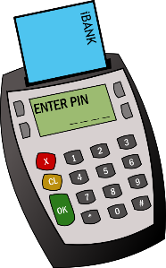
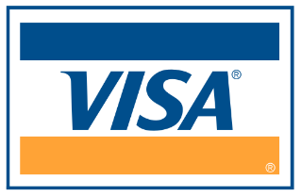
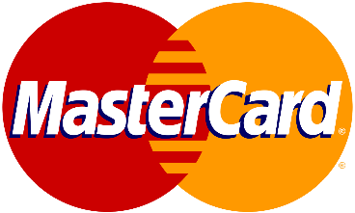
Digital Currency

Slide 4
Digital Currency
Digital currency (digital money, electronic money or electronic currency) is a type of currency available in digital form (in contrast to physicals, such as banknotes and coins). It exhibits properties similar to physical currencies but can allow for instantaneous transactions and borderless transfer-of-ownership.
The Digital Currency can be classified into two group:
1.Centralized ( MasterCard ,keycard ,visa card ,PayPal )
2.Decentralized (cryptocurrency)

Slide 6
-its purest form is a peer-to-peer version of electronic cash. It allows online payments to be sent directly from one party to another without going through a financial institution.
Cryptocurrency
The Cryptocurrency based heavily on Blockchain technology

Slide 7
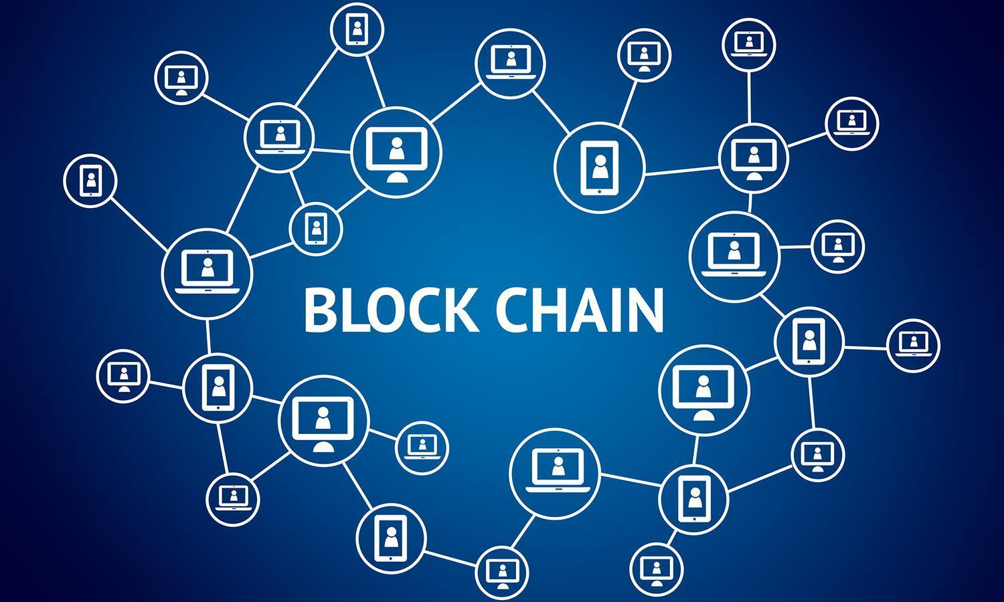

Slide 8
The Blockchain
1991

Slide 10
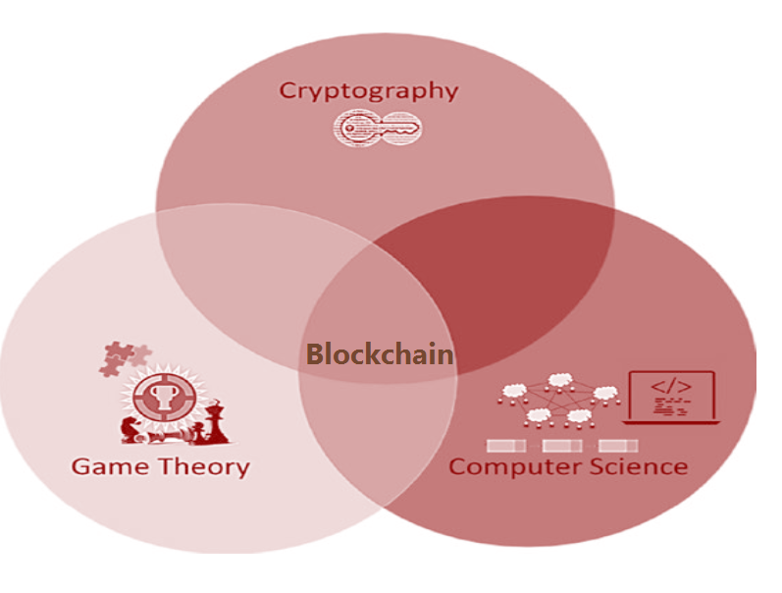
The Blockchain Development
Technically, Blockchain is a brilliant amalgamation of the concepts from cryptography, game theory, and computer science engineering.

Slide 11
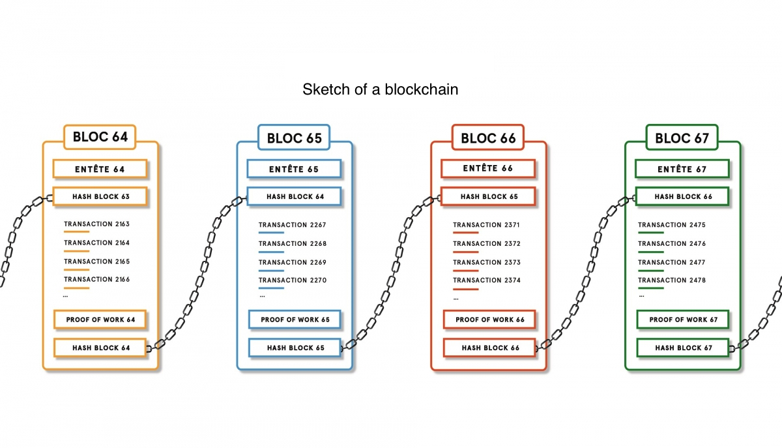
Simple data structure of Blockchain
is a massively replicated database of all transactions in the Bitcoin network. It uses a consensus mechanism called proof-of-work which prevents double-spending in the network. Work on p2p network based on consensus protocol .

Slide 12
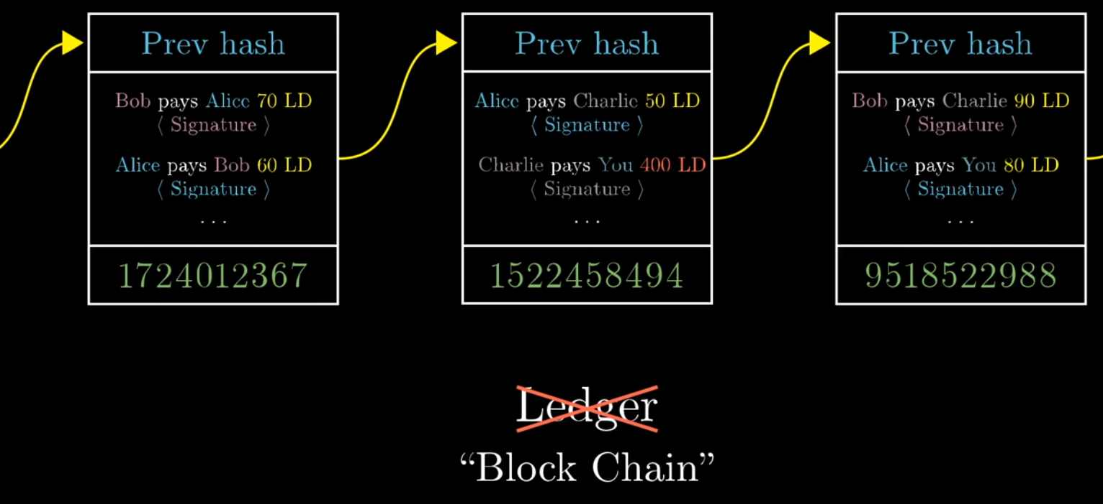

Slide 13
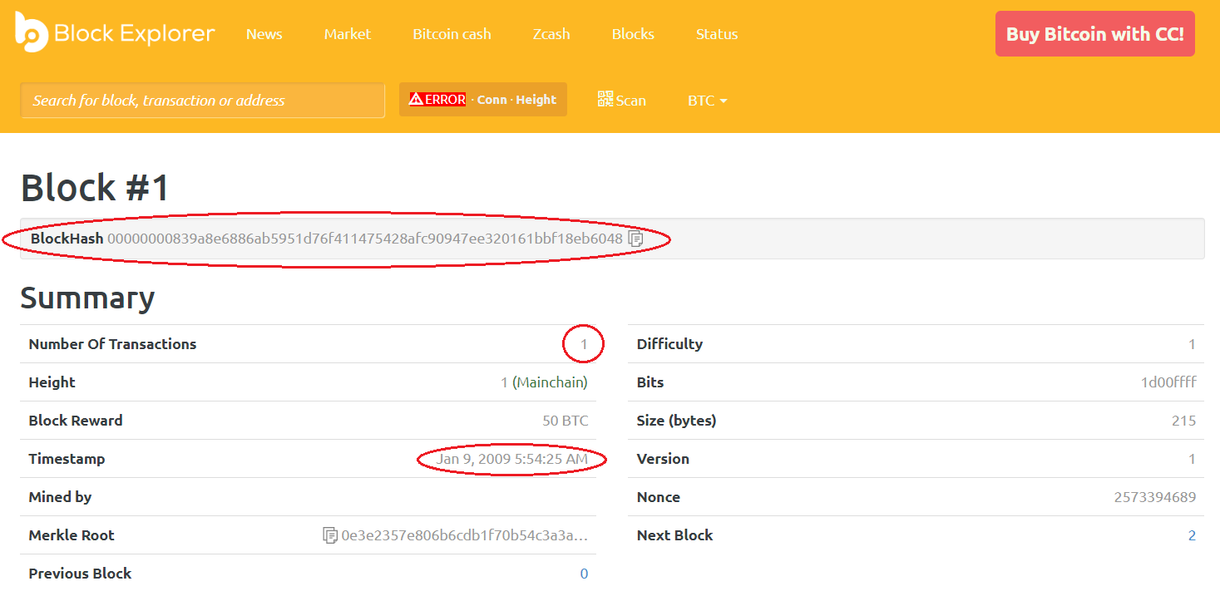

Slide 14
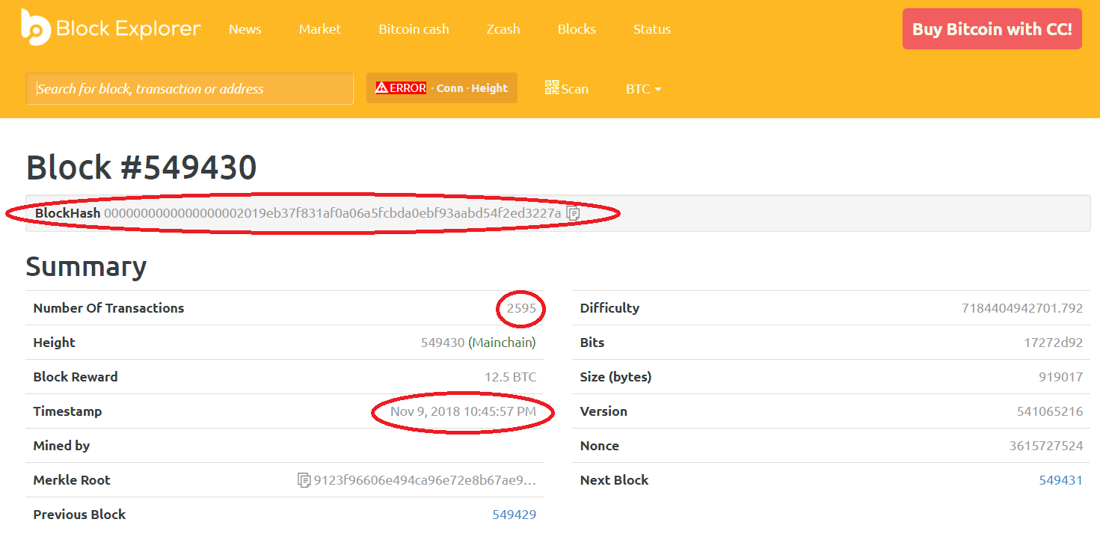

Slide 15
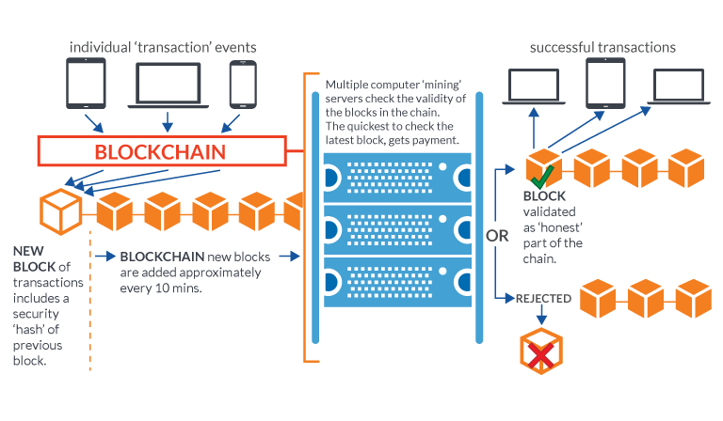
How to Add Block to Blockchain
Mining Operation

Slide 16
The Blockchain Types
Private (Closed to select group of authorized users such as group of banks)
Public (Open to everyone to view or access)
Hybrid (The private access see all data , while the public can see only selections)

Slide 17
The Benefit of Blockchain
Border participant
Lower cost
Save time
No tampering ; Freud; Cybercrime

Slide 18
The Blockchain Trust
Trust Central Authority ←→ Trust Computational Work
Main Idea
Digital Signature
The ledger is the currency
Decentralize
Proof of work

Slide 19
The Policy Question Blockchain
Governance
International Laws
Security
Economics

Slide 20
Thank you

