Slide 1
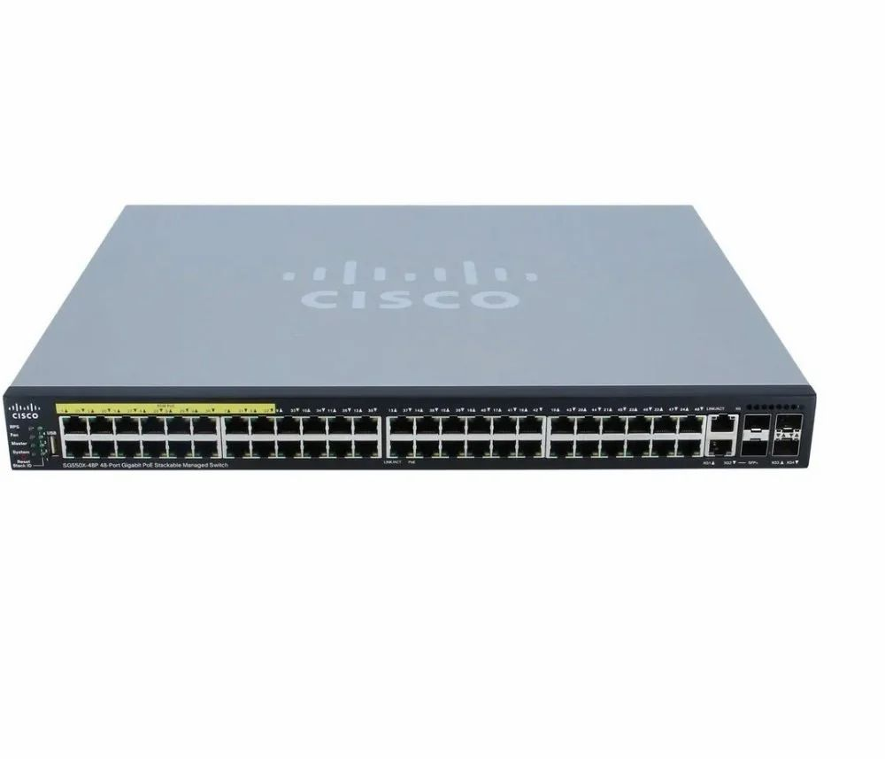
VLANS

Slide 2



PC0 PC1 → VLAN10 PC2 PC3 → VLAN20 PC4 PC5 → VLAN30 PC6 PC7 → VLAN40
PC0
PC1
PC2 PC3
PC4 PC5
PC6 PC7
VLAN10
VLAN20
VLAN30
VLAN40
Management
Accounting
Sales
IT

Slide 3
Switch0 → CLI
1
2
interface fa0/1 switchport mode access switchport access vlan 10
interface fa0/2 switchport mode access switchport access vlan 10
interface fa0/3 switchport mode access switchport access vlan 20
interface fa0/4 switchport mode access switchport access vlan 20
enable configure terminal
vlan 10
name Management
vlan 20
name Accounting
vlan 30
name Sales
vlan 40
name IT

Slide 4
Switch1
1
2
interface fa0/1 switchport mode access switchport access vlan 30
interface fa0/2 switchport mode access switchport access vlan 30
interface fa0/3 switchport mode access switchport access vlan 40
interface fa0/4 switchport mode access switchport access vlan 40
enable configure terminal
vlan 10 vlan 20 vlan 30 vlan 40

Slide 5
Trunk Switch0 & Switch1:
Switch0
Switch1
interface fa0/24 switchport mode trunk
interface fa0/24 switchport mode trunk
Switch0 → Router
Fa0/23 → G0/0
interface fa0/23 switchport mode trunk

Slide 6
Inter-VLAN Routing
enable configure terminal
interface g0/0 no shutdown
VLAN10
interface g0/0.10 encapsulation dot1Q 10 ip address 192.168.10.1 255.255.255.0
VLAN20
interface g0/0.20 encapsulation dot1Q 20 ip address 192.168.20.1 255.255.255.0
VLAN30
interface g0/0.30 encapsulation dot1Q 30 ip address 192.168.30.1 255.255.255.0
VLAN40
interface g0/0.40 encapsulation dot1Q 40 ip address 192.168.40.1 255.255.255.0

Slide 7
IP FOR COMPUTER
VLAN10
PC0 → 192.168.10.10 PC1 → 192.168.10.11
Gateway 192.168.10.1
VLAN20
PC2 → 192.168.20.10 PC3 → 192.168.20.11
Gateway 192.168.20.1
VLAN30
PC4 → 192.168.30.10 PC5 → 192.168.30.11
Gateway 192.168.30.1
VLAN40
PC6 → 192.168.40.10 PC7 → 192.168.40.11
Gateway 192.168.40.1

Slide 8
PING TEST
PC0:
ping 192.168.40.10
✔ VLAN
✔ Trunk
✔ Inter-VLAN Routing

