Slide 1
Dynamic Routing
OSPF
EIGRP

Slide 2
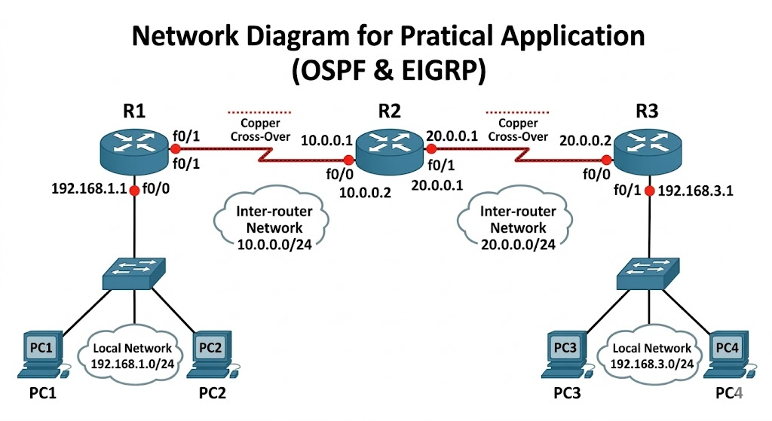

Slide 3
Network use
Link | Network
R1 ↔ R2 | 10.0.0.0/24
R2 ↔ R3 | 20.0.0.0/24
LAN R1 | 192.168.1.0/24
LAN R3 | 192.168.3.0/24

Slide 4

Pc IP Conf
PC1
PC2
PC3
PC4
IP: 192.168.1.10
Mask: 255.255.255.0
Gateway: 192.168.1.1
IP: 192.168.3.10
Gateway: 192.168.3.1
IP: 192.168.1.11
Gateway: 192.168.1.1
IP: 192.168.3.11
Gateway: 192.168.3.1

Slide 5
R1
R2
R3
enable
conf t
interface fa0/0
ip address 192.168.1.1 255.255.255.0
no shutdown
interface fa0/1
ip address 10.0.0.1 255.255.255.0
no shutdown
router ospf 1
network 192.168.1.0 0.0.0.255 area 0
network 10.0.0.0 0.0.0.255 area 0
enable
conf t
interface fa0/0
ip address 10.0.0.2 255.255.255.0
no shutdown
interface fa0/1
ip address 20.0.0.1 255.255.255.0
no shutdown
router ospf 1
network 10.0.0.0 0.0.0.255 area 0
network 20.0.0.0 0.0.0.255 area 0
enable
conf t
interface fa0/0
ip address 20.0.0.2 255.255.255.0
no shutdown
interface fa0/1
ip address 192.168.3.1 255.255.255.0
no shutdown
router ospf 1
network 20.0.0.0 0.0.0.255 area 0
network 192.168.3.0 0.0.0.255 area 0

Slide 6
OSPF
show ip route
show ip ospf neighbor
PC1
ping 192.168.3.10
enable
write erase
reload

Slide 7
OSPF + EIGRP + Redistribution
enable
conf t
interface fa0/0
ip address 10.0.0.2 255.255.255.0
no shutdown
interface fa0/1
ip address 20.0.0.1 255.255.255.0
no shutdown
! OSPF
router ospf 1
network 10.0.0.0 0.0.0.255 area 0
! EIGRP
router eigrp 100
no auto-summary
network 20.0.0.0 0.0.0.255
! Redistribution
router ospf 1
redistribute eigrp 100 subnets
router eigrp 100
redistribute ospf 1 metric 10000 100 255 1 1500
end
(R1) → OSPF
enable
conf t
interface fa0/0
ip address 192.168.1.1 255.255.255.0
no shutdown
interface fa0/1
ip address 10.0.0.1 255.255.255.0
no shutdown
router ospf 1
network 192.168.1.0 0.0.0.255 area 0
network 10.0.0.0 0.0.0.255 area 0
end
(R2) → OSPF + EIGRP

Slide 8
(R3) → EIGRP
enable
conf t
interface fa0/0
ip address 20.0.0.2 255.255.255.0
no shutdown
interface fa0/1
ip address 192.168.3.1 255.255.255.0
no shutdown
router eigrp 100
no auto-summary
network 20.0.0.0 0.0.0.255
network 192.168.3.0 0.0.0.255
end
ping 192.168.3.10

