Slide 1
ITIG
Network Security | NAT | ACL | Troubleshooting

Slide 2
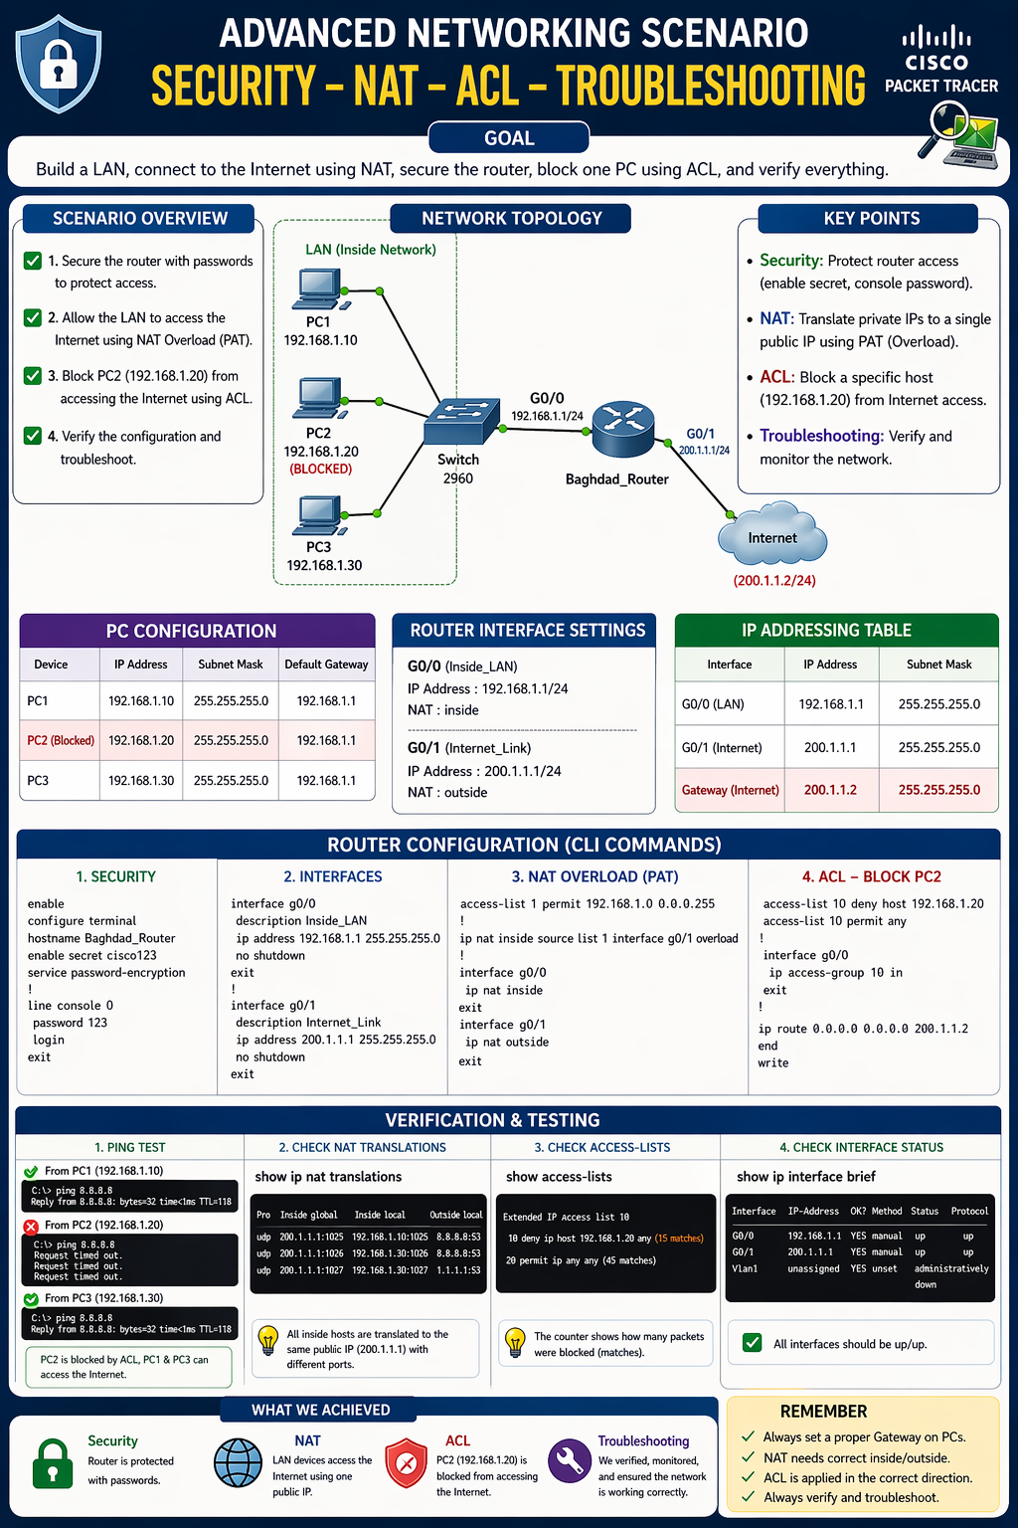

Slide 3
PC IP
PC1: IP: 192.168.1.10 Subnet: 255.255.255.0 Gateway: 192.168.1.1
PC2: IP: 192.168.1.20 Subnet: 255.255.255.0 Gateway: 192.168.1.1
PC3: IP: 192.168.1.30 Subnet: 255.255.255.0 Gateway: 192.168.1.1

Slide 4
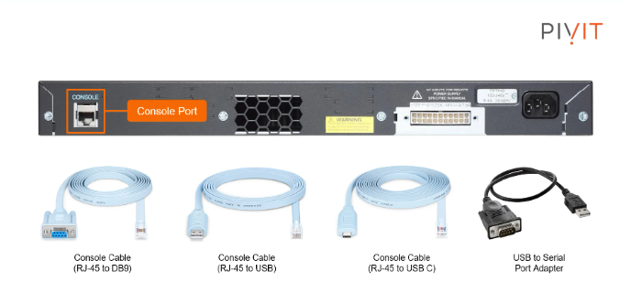
Security
enable configure terminal
hostname Baghdad_Router
! --- Security --- enable secret cisco123 service password-encryption
line console 0 password 123 login exit

Slide 5
Router conf
--- Interfaces --- interface g0/0 description LAN ip address 192.168.1.1 255.255.255.0 no shutdown exit
interface g0/1 description INTERNET ip address 200.1.1.1 255.255.255.0 no shutdown exit

Slide 6
NAT
ACL
! --- NAT --- access-list 1 permit 192.168.1.0 0.0.0.255
ip nat inside source list 1 interface g0/1 overload
interface g0/0 ip nat inside exit
interface g0/1 ip nat outside exit
! --- ACL --- access-list 10 deny host 192.168.1.20 access-list 10 permit any
interface g0/0 ip access-group 10 in exit
! --- Default Route --- ip route 0.0.0.0 0.0.0.0 200.1.1.2
end write

Slide 7
Server
interface g0/1
ip address 200.1.1.1 255.255.255.0
no shutdown
IP Address: 200.1.1.2
Subnet Mask: 255.255.255.0
Default Gateway: 200.1.1.1
Server → Services → HTTP → ON
Web Browser
http://200.1.1.2
ping 200.1.1.2

Slide 8
Wildcard Mask
Wildcard Mask | 0.0.0.255
Subnet Mask | 255.255.255.0
192.168.1
0.0.0.255
Exmp 1
Exmp 2
Subnet Mask: 255.255.255.0
Subnet Mask: 255.255.255.192
255-255=0
255-255=0
255-255=0
255-0=255
255-255=0
255-255=0
255-255=0
255-192=63
0.0.0.255
0.0.0.63

Slide 9
Subnet | Wildcard
255.255.255.0 | 0.0.0.255
255.255.255.128 | 0.0.0.127
255.255.255.192 | 0.0.0.63
255.255.255.224 | 0.0.0.31
255.255.255.240 | 0.0.0.15

