Slide 1
Static Routing

Slide 2
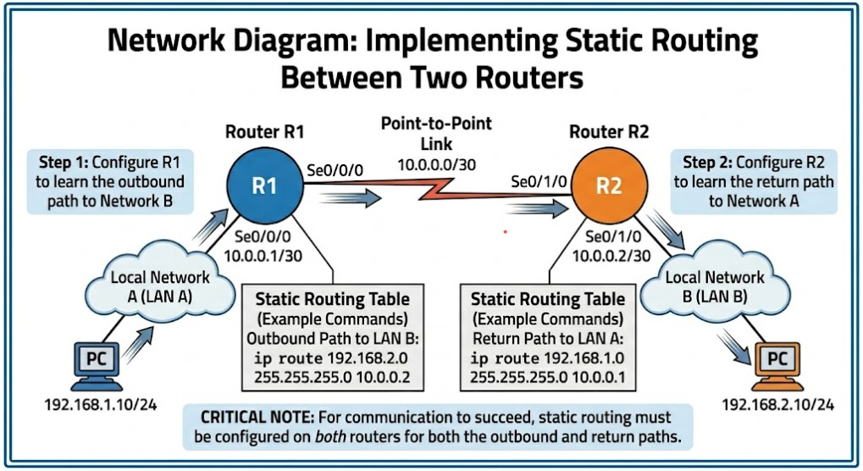

Slide 3
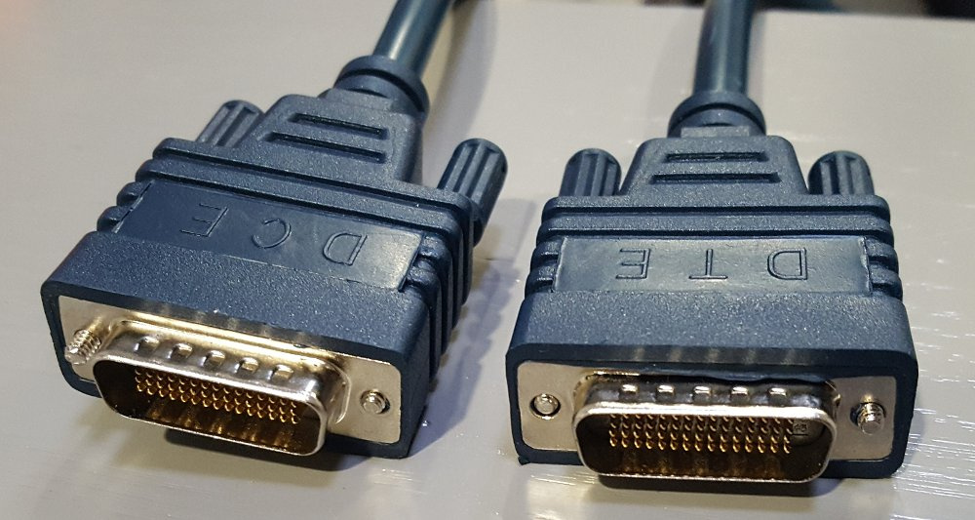
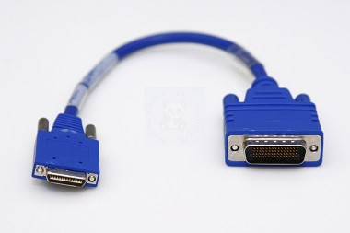
Smart Serial to DB60 - DTE to DCE
DTE
Data Terminal Equipment
DCE
Data Circuit-terminating Equipment

Slide 4
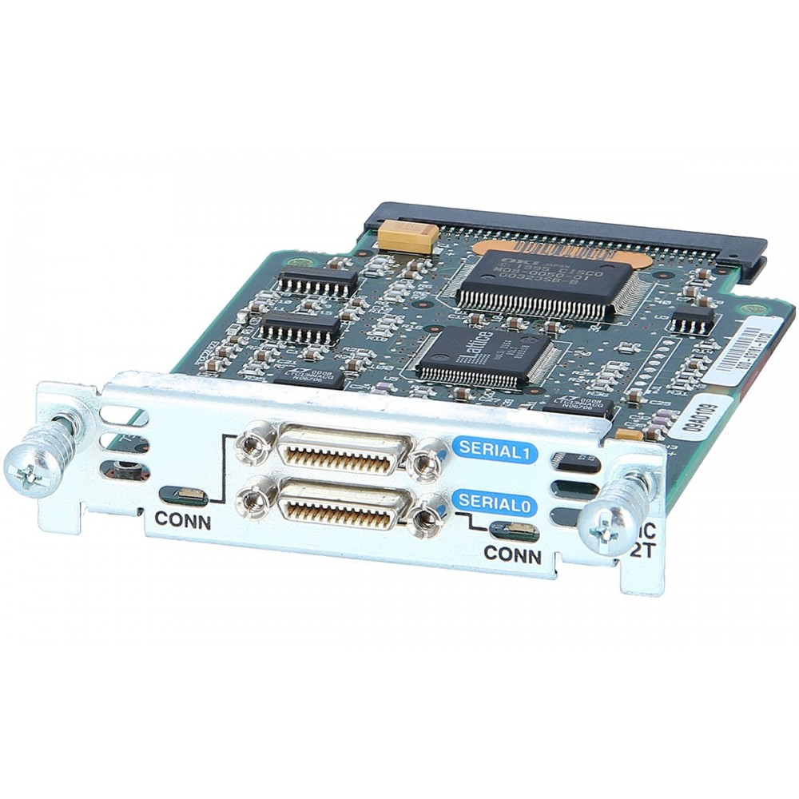
HWIC-2T
High-Speed WAN Interface Card

Slide 5

(IP Addressing)
This Photo by Unknown Author is licensed under CC BY-SA-NC
This Photo by Unknown Author is licensed under CC BY-SA-NC
PC-A
PC-B
IP Address: 192.168.1.10
Subnet Mask: 255.255.255.0
Default Gateway: 192.168.1.1 R1
IP Address: 192.168.2.10
Subnet Mask: 255.255.255.0
Default Gateway: 192.168.2.1 R2

Slide 6
CLI Configuration
ROU 1
ROU 2
enable
configure terminal
interface gig0/0
ip address 192.168.2.1 255.255.255.0
no shutdown
interface serial 0/1/0
ip address 10.0.0.2 255.255.255.252
no shutdown
ip route 192.168.1.0 255.255.255.0 10.0.0.1
enable
configure terminal
interface gig0/0
ip address 192.168.1.1 255.255.255.0
no shutdown
interface serial 0/0/0
ip address 10.0.0.1 255.255.255.252
no shutdown
ip route 192.168.2.0 255.255.255.0 10.0.0.2
show ip route

Slide 7

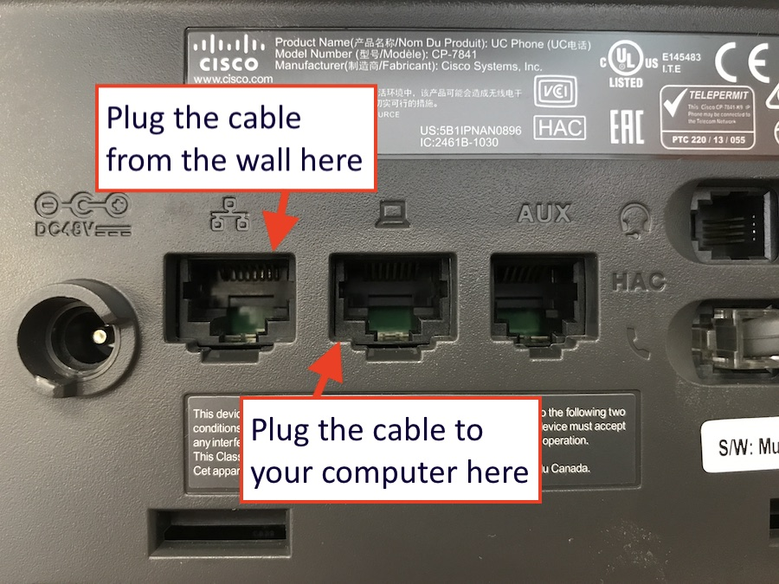
IP Phone VOIP

Slide 8


Router 2811
Switch 2960.
IP Phone 7960
2900
3900
4000
ISR
POE
Grandstream
Polycom

Slide 9
Switch CLI
ROU CLI
Telephony Service
enable
configure terminal
interface fa0/0
ip address 192.168.1.1 255.255.255.0
no shutdown
exit
ip dhcp pool MY_VOICE
network 192.168.1.0 255.255.255.0
default-router 192.168.1.1
option 150 ip 192.168.1.1
exit
telephony-service
max-dn 5
max-ephones 5
ip source-address 192.168.1.1 port 2000
auto assign 1 to 5
exit
enable
configure terminal
interface range fa0/1-10
switchport mode access
switchport voice vlan 1
exit
TELEPHONE NUMBER
ephone-dn 1
number 101
exit
ephone-dn 2
number 102
exit

