Slide 1
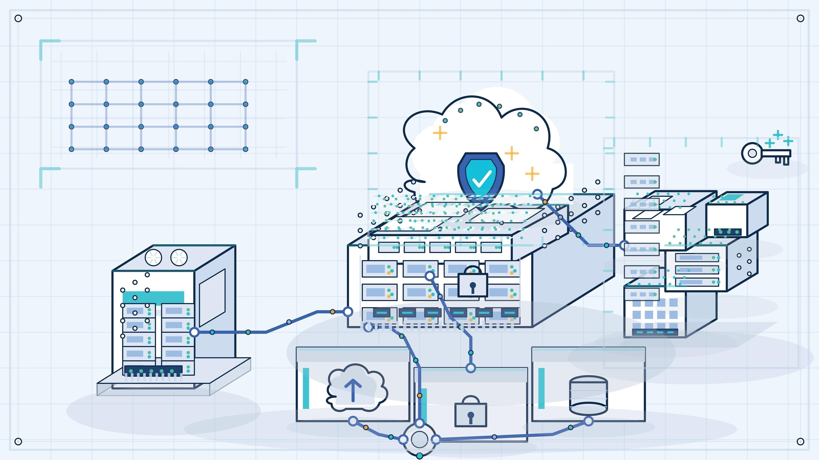
Network Security: SSH, Port Security, Hardening

Slide 2



01
02
PC 0
PC 1
192.168.1.5
192.168.1.6
192.168.1.100

Slide 3
Lab 1: Device Hardening (System Security)
enable
configure terminal
hostname Iraq-Switch
enable secret 12345
service password-encryption
banner motd # Unauthorized Access Strictly Prohibited #
line console 0
password ConsolePass
login
exit

Slide 4

Lab 2: Management Security (SSH Configuration)
interface vlan 1
ip address 192.168.1.10 255.255.255.0
no shutdown
exit
ip domain-name academy.local
crypto key generate rsa
# Type 1024 when prompted
username admin secret admin123
line vty 0 4
transport input ssh
login local
exit
ssh -l admin 192.168.1.10

Slide 5
Lab 3: Port Security (Layer 2 Security)
enable
configure terminal
interface vlan 1
ip address 192.168.1.10 255.255.255.0
no shutdown
exit
interface fa0/1
switchport mode access
switchport port-security
switchport port-security maximum 1
switchport port-security mac-address sticky
switchport port-security violation shutdown
exit
do write

Slide 6
Lab 4: Verification & Maintenance (Commands)
# To save all configurations:
do write
# To check Port Security status:
show port-security interface fa0/1
# To check SSH status:
show ip ssh
# To reset a port after a violation (Err-disabled):
interface fa0/1
shutdown
no shutdown
exit

Slide 7
Shutdown All Ports
Re-enable Ports
interface range fa0/1 - 24
shutdown
interface range fa0/1 - 24
no shutdown
Port Security Range
interface range fa0/1 - 10
switchport mode access
switchport port-security
switchport port-security maximum 1
switchport port-security mac-address sticky
switchport port-security violation shutdown

