Slide 1

Chapter 01

Slide 2


Course Outline
Computer Forensics in Today’s World
  Understand the fundamentals of Computer Forensics
  Understand Cybercrimes and their investigation procedures
  Understand Digital Evidence and eDiscovery
  Understand Forensics Readiness
  Understand the Role of Various Processes and Technologies in Computer Forensics
  Identify the Roles and Responsibilities of a Forensic Investigator
  Understand the Challenges Faced in Investigating Cybercrimes
  Understand Various Standards and Best Practices Related to Computer Forensics
  Understand Laws and Legal Compliance in Computer Forensics

Slide 3
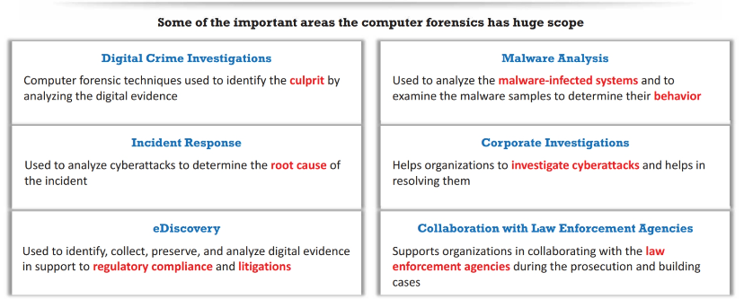
Scope of Computer Forensics

Slide 4
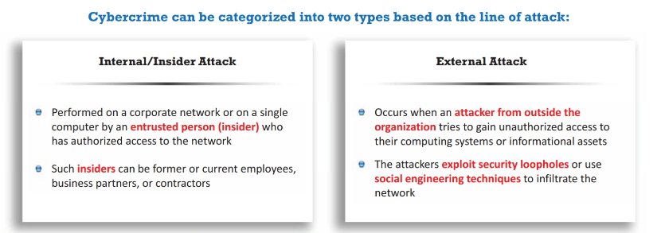
Cyber Crimes

Slide 5
Examples of Cyber Crimes
Espionage
Trojan Horse
Brute-Force
DoS
Theft of Intellectual Property
Manipulation of Data
SQL Injection
Phishing/Spoofing
Privilege Escalation
Cyber Defamation
Cyberterrorism
Cyberwarfare

Slide 6

Cyber Attribution Techniques
Forensic Analysis Tool
Technical Indicators
Past Attacks
Attack Motivations

Slide 7
Cyber Crime Investigation
Meticulous Collection of Clues
Forensic Evidence
Electronic Device
Containing Valuable Evidence
Investigation
Civil Approach
Criminal Approach
Administrative Approach

Slide 8
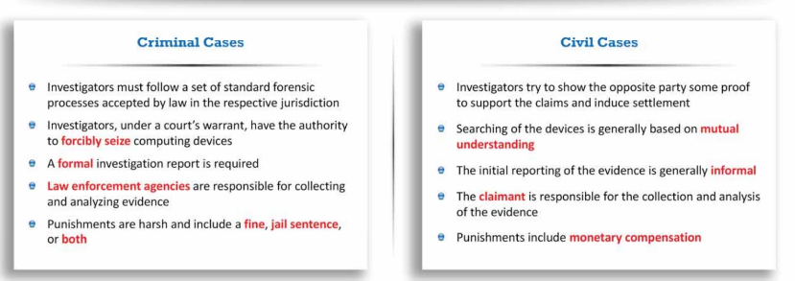
Civil Vs. Criminal Investigation

Slide 9
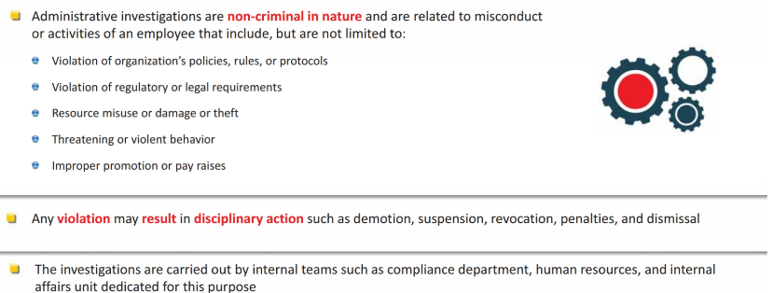
Administrative Investigation

Slide 10
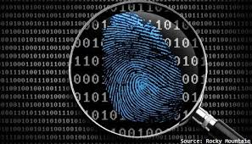
Digital Evidence
Volatile Data
Non-Volatile Data

Slide 11
Roles Digital Evidence
Proof of an Act
Corroborative Evidence
Contradictory Evidence
Linking Evidence
Exculpatory Evidence
Contextual Evidence
Timeline Construction
Identity Verification
Policy Verification
Compliance Verification

Slide 12
Sources of Potential Evidence
User Created Files
Database Files
Media Files
Document Files
Internet Bookmarks
Internet Favorites
Emails
Cloud Storage Files
Hidden Partitions
Address Books

Slide 13
Sources of Potential Evidence
User Protected Files
Compressed Files
Misnamed Files
Encrypted Files
Password Protected Files
Hidden Files
Steganography
Blockchain Ledgers

Slide 14
Sources of Potential Evidence
Computer Created Files
Backup Files
Log Files
Configuration Files
Printer Spool Files
Cookies
Swap Files
System Files
History Files
Temporary Files

Slide 15
Sources of Potential Evidence
Hard Drive
Memory Card
Smart Card
Dongle
Biometric Scanner
Answering Machine
Digital Camera
CCTV Camera
RAM
Hand Held Devices
LAN/NIC Card
Router/Modem/Hub/Switch
Server
Printer
IoT Wearable
GPS
Telephone

Slide 16
Sources of Potential Evidence
Credit Card Skimmers
Digital Watches
VoIP (SKYPE, Teams, Zoom)
Databases
Web Based Platform (Forms, E-Commerce)
ATM
POS
Virtual Machines
Blockchain
Cryptocurrencies

Slide 17
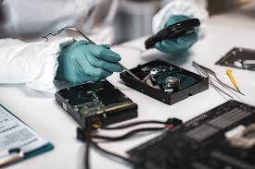
Rules of Evidence
Understandable
Admissible
Authentic
Reliable
Complete
Materiality

Slide 18
Federal Rules of Evidence
Rule 102: Purpose
Rule 104: Preliminary Questions
Rule 103: Rulings of Evidence
Rule 105: Limited Admissibility
Rule 801: Hearsay Rule
Rule 801: Statements that are Not Hearsay

Slide 19
Federal Rules of Evidence
Rule 803: Hearsay Exceptions (availability of Declarant Immaterial)
Rule 804: Hearsay Exceptions (Declarant Unavailable)
Rule 1001: Definitions that apply
Rule 1002: Requirement of Original
Rule 1003: Admissibility of Duplicates
Rule 1004: Admissibility of Other Evidence of Contents

Slide 20
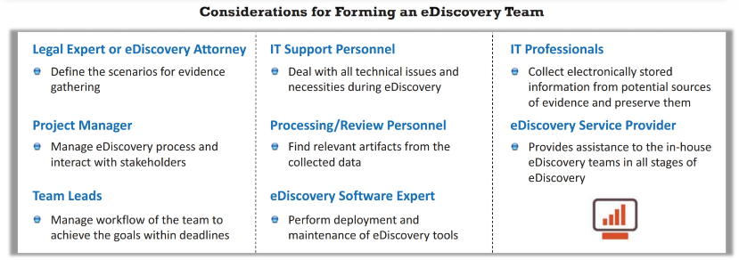
eDiscovery Team

Slide 21
Handling Digital Evidence
Detailed Record
Data, Time, Purpose, Action
Digital Log
No Alteration of Evidence
Forensic Tools
Secure Location
Write Blockers
Documents
Anti-Static Bags
Authorized Individuals

Slide 22
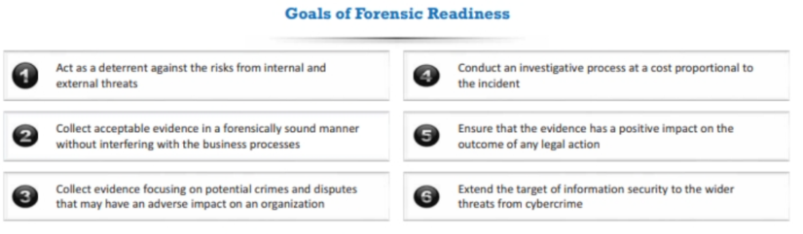
Forensic Readiness

Slide 23
Key Principles of Forensics Readiness
Clear Business Objectives
Comprehensive Policy
Evidence Collection
Secure Storage
Chain of Custody
Regular Audit and Review
Legal/Regulatory Awareness
Incident Response Integration
Procedures:
Maintain an Inventory
Host Monitoring
Network Monitoring

Slide 24
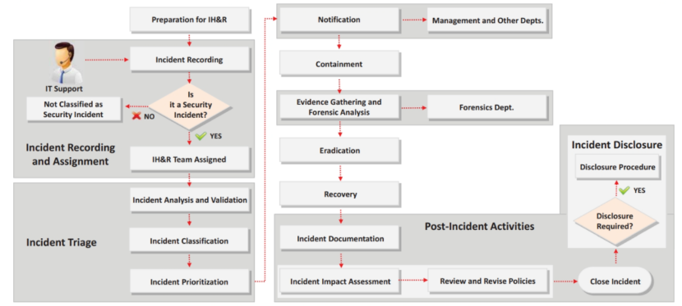
Incident Response Flow

Slide 25
Threat Intelligence Role with Forensics
Automated Data Analysis
Knowledge Presentation
Reasoning Process
Knowledge Discovery
Expert Systems
Recognizing Patterns
Image and Video Analysis
Natural Language Processing (NLP)
Predictive Analysis

Slide 26
Need for Forensic Investigator
Cybercrime Profiling
Cybercrime Investigation
Evidence in Digital Form
Complex Digital Environment
Preservation of Evidence
Legal Standards
Litigation Support
Incident Handling and Response
Expert Testimony

Slide 27
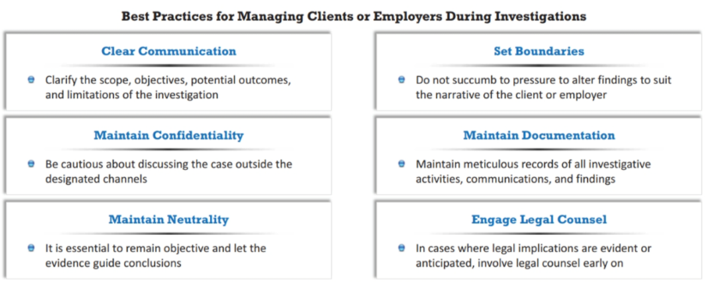
During Investigation

Slide 28
Computer Forensics Resources
Associations offering computer forensic
Information High Technology Crime Investigation Association (HTCIA)
International Association of Chiefs of Police (IACP)
Association of Cyber Forensics and Threat Investigators (ACFTI)
Computer Technology Investigators Network (CITN)
Forensic Focus The Association of Digital Forensics, Security and Law (ADFSL)

Slide 29
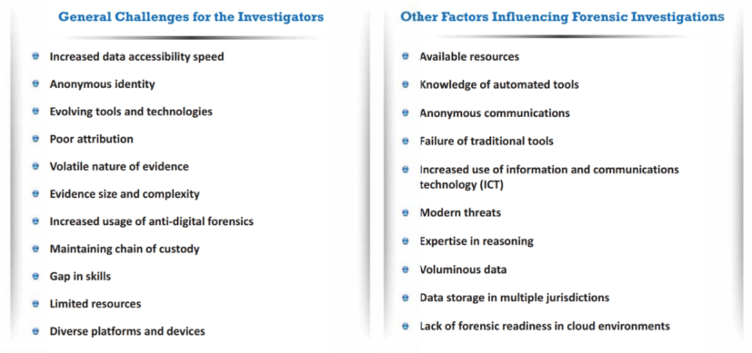
Challenges

Slide 30
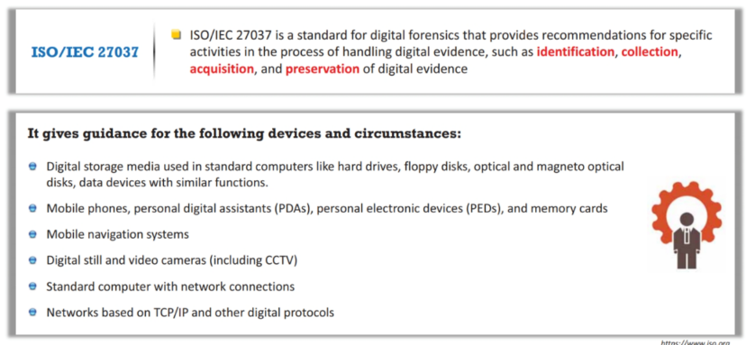
Forensic Standards

Slide 31
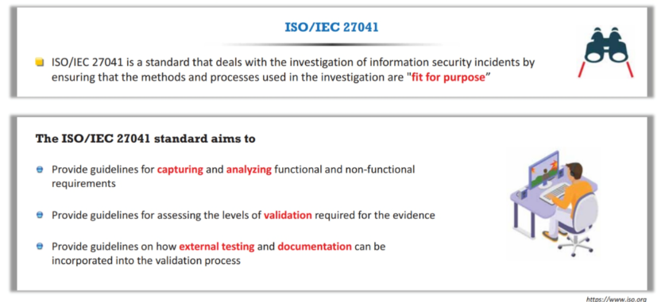
Forensic Standards

Slide 32
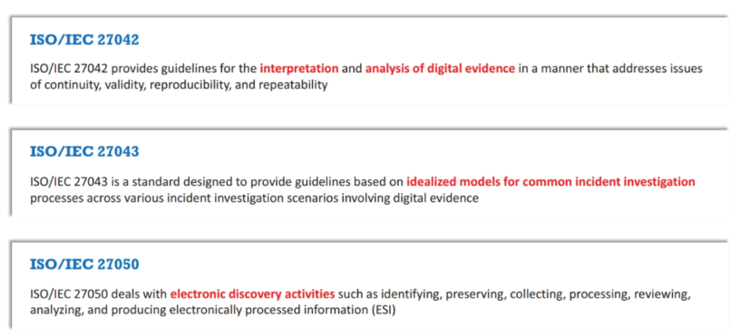
Forensic Standards

Slide 33
Computer Forensics International Standards
Gramm-Leach-Bliley Act (BLA)
Federal Information Security Modernization Act (FISMA)
Health Insurance Portability and Accountability Act (HIPPA)
Electronic Communications Privacy Act
General Data Protection Regulation (GDPR)
Data Protection Act (DPA)
Payment Card Industry Data Security Standard (PCI-DSS)
Sarbanes-Oxley Act (SOX)

Slide 34
Course Outline
Computer Forensics Investigation Process
  Understand the Forensic Investigation Process and Its Importance
  Understand First Response
  Understand the Pre-Investigation Phase
  Understand the Investigation Phase
  Understand the Post-Investigation Phase

Slide 35
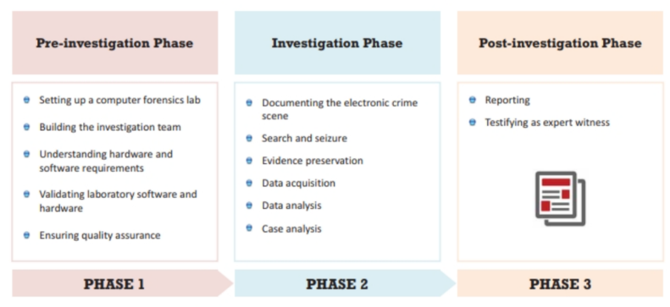
Investigation Process
Methodological Approach to Investigate
Ensure of Integrity
Comply to Standards and Local Laws
Follow repeatable and well documented set of steps

Slide 36
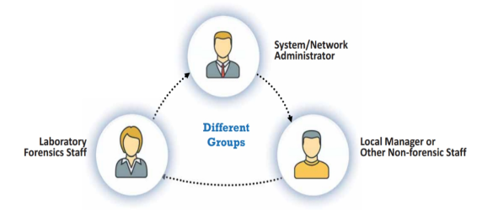
First Response
First Action performed
Prevents Further Damage
Helps investigation
Identify Crime Scene
Collect Information about Evidence
Protect Crime Scene
Preserve Temporary and Fragile Evidence
Document All Finding
Package and Transport Electronic Evidence
Gather Preliminary Information from Crime Scene
Arrives First to Crime Scene
Law Enforcement
Preserving the Evidence
Crime Scene in Lawful Manner

Slide 37

First Response
System/Network Admin
Based on the incident, system/network administrators can take the following measures:
Record the contents of the screen if the computer is switched on
Transfer copies of system logs onto clean media
If an ongoing attack is detected, seek top management approval before powering down any computing systems
Isolate the computing systems and other digital devices from further use or tampering
Document every detail relevant to the incident

Slide 38

First Response
Lab Forensic Staff
Photograph
Individual Interviews
Search and Seizure
Initial Search
Powered OFF/ON devices
Electronic Evidence Proper Details
Label the Containers
Chain of Custody
Shutdown or Reboot
Mistakes
Reliable or Usable Components of Computers
Not Have Access to Computer Documentation
Fail to Document or Data Collection

Slide 39
Setup up
Computer Forensic Lab
Investigation Team
Planning and Budgeting
Physical and Structural Design
Work Area
Physical Security
Human Resources
Forensic Lab Licensing
  ISO/IEC 17025 accreditation
  ASCLD/Lab Accreditation
Photographer
Incident Responder
Incident Analyzer
Evidence Examiner
Evidence Documenter
Evidence Manager
Evidence Witness
Attorney

Slide 40
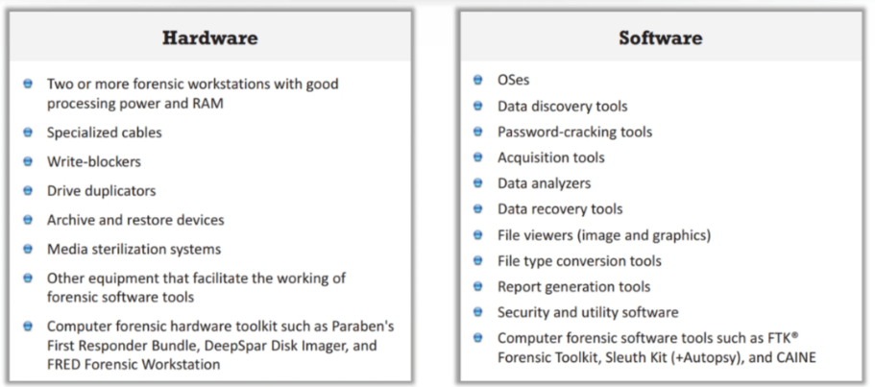
Hardware
Software of Forensic Lab

Slide 41
Validation of Forensic Lab
Validation Process
Precise Results
Forensic Lab License
Latest version of Tools
Proper Maintenance
Document Test Methodology
SOP (Standard Operating Procedure)
CFTT (Computer Forensic Tool Testing Project)
Ensure Quality Assurance

Slide 42
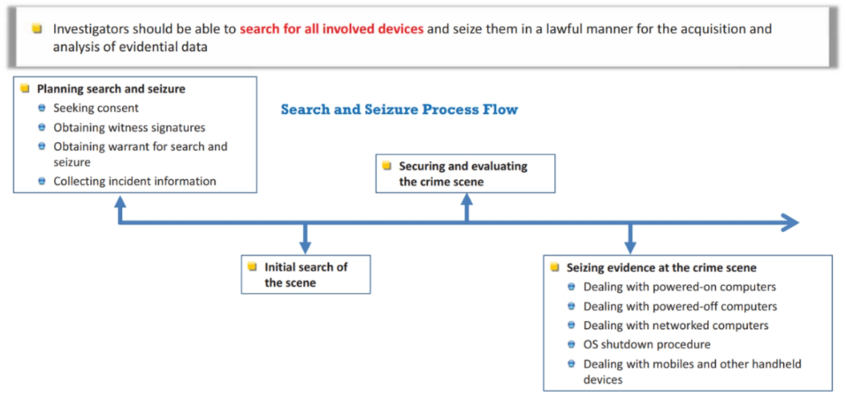
Documenting Electronic Crime Scene
Document Physical Crime Scene
Electronic Components
State of Computer Systems
Computer Monitor Screen

Slide 43

Planning Search and Seize
Description of the incident
Case name or title of the incident
Location of the incident
Applicable jurisdiction and relevant legislation
Determining the extent of authority to search
Creating a chain of custody document
Details of equipment to be seized
Search and seizure type (overt/covert)
Approval from local management
Health and safety precaution

Slide 44
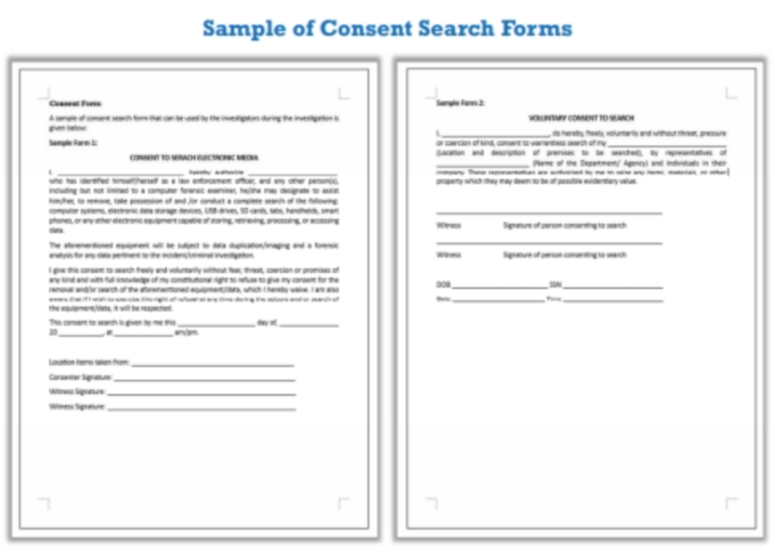
Seeking Consent

Slide 45
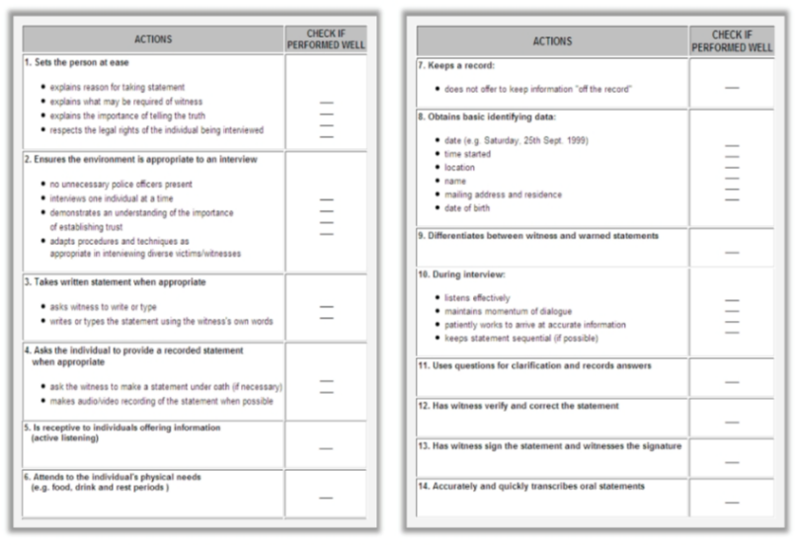
Obtain Witness Signature

Slide 46
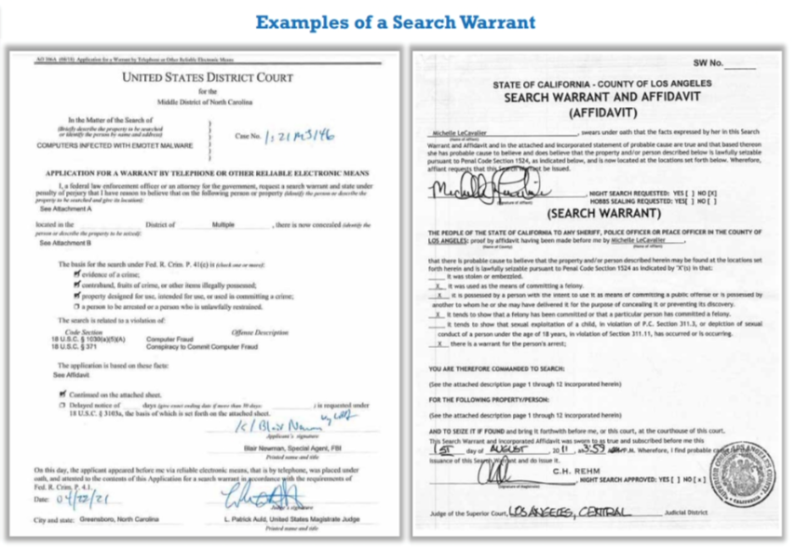
Search Warrant

Slide 47
Collect Incident Information
Adhering to departmental policies and applicable laws, first responders must gather the following information about victim devices and connected systems:
Actual holders and/or users of any electronic device present at the crime scene
Web mail and social networking website account information
Usernames
Internet service providers
Passwords required to access the resources
Purpose of using the system
Automatic applications in use
Any offsite data storage
Unique security schemes or destructive devices
Documents detailing the installation of hardware or software on the system

Slide 48

Operating System Shutdown Procedure

Slide 49
Chaing of Custody
The chain of custody document contains complete information about the obtained evidence such as:
Case number
Name and title of the person who provided information
Address and telephone number
Location of evidence
Date/time of evidence
Item number/quantity/description of item

Slide 50
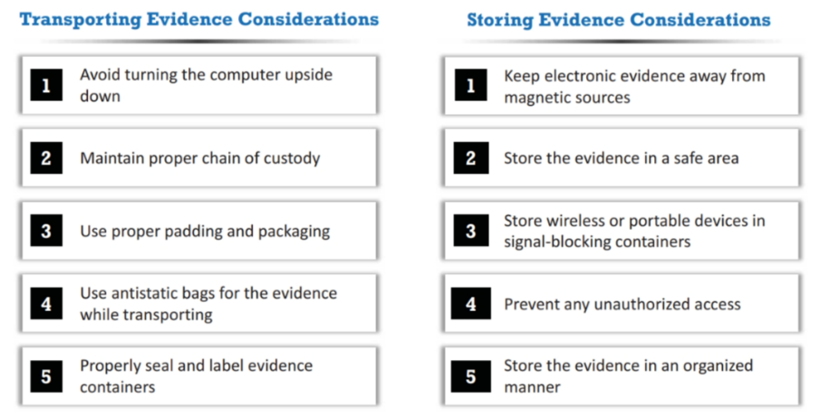
Transport and Store Evidence

Slide 51
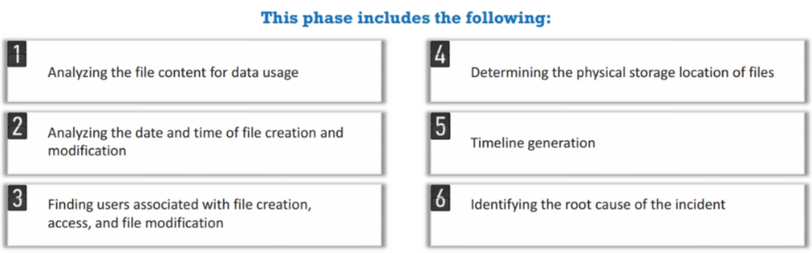
Data Analysis

Slide 52
Case Analysis
Case Background
Analysis Strategy
Legal Considerations
Available Resources
Evidence Scope
Chain of Custody
Timelines and Priorities

Slide 53
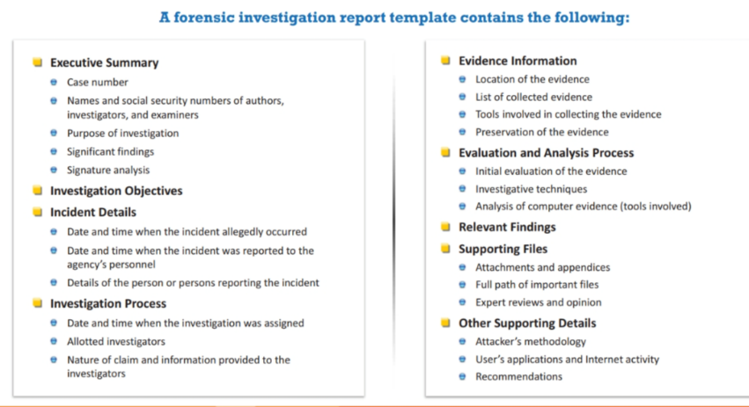
Forensic Investigation Report

Slide 54
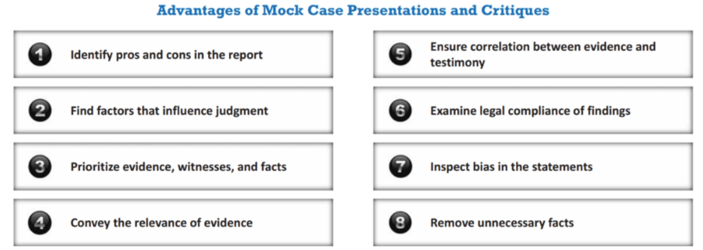
MOCK Case

Slide 55
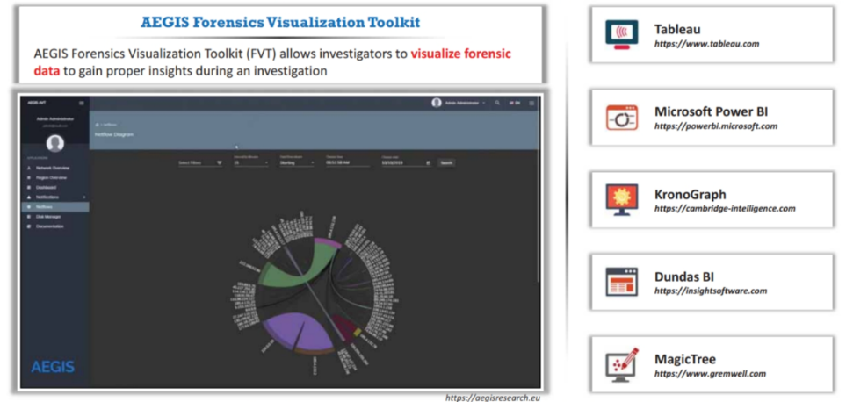
Forensic Vizualization

Slide 56

شكراً لكم
Thank You
trainingcentre@tahaluf.ae

