Slide 1

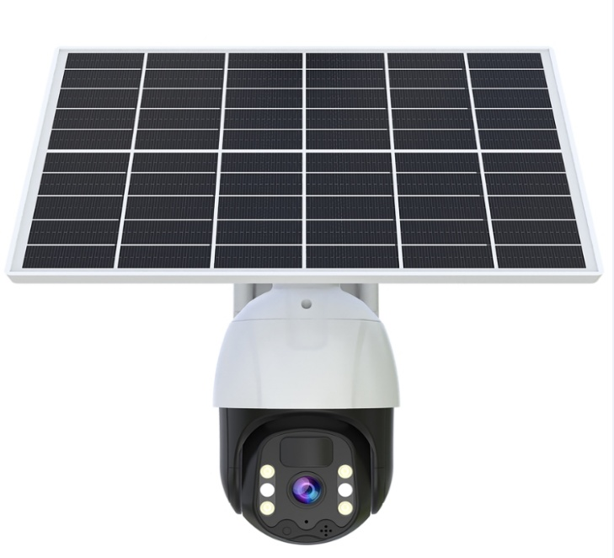
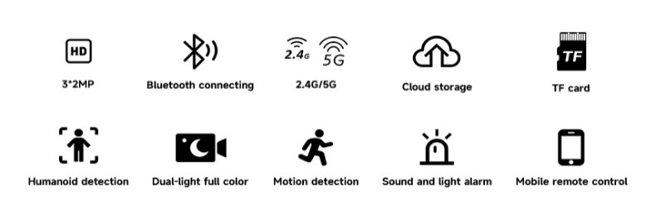
Single-Len Solar-Camera 4G/WiFi
Model | CG17
APPICATION: | Eseecloud
OPERATED SYSTEM: | Android, Apple IOS
RESOLUTION: | 4MP
PIXEL: | 2560*1440
PTZ ANGLE: | 355° PTZ Rotation + 75° Tilt Angle
Internet Connection: | WIFI/4G/5G optional
POWER SUPPLY: | 3.5W Solar Panel
Battery Capacity: | Built-in 8000mah battery
DETECTION MODE: | PIR Human sensing +AI human detection
AUDIO: | Support Two-way Audio(Built-in speaker )
Cloud storage/Local storage: | Support/Support TF SD card (Max 256G)
Night Vision: | Full-Color Night Vision

Slide 2
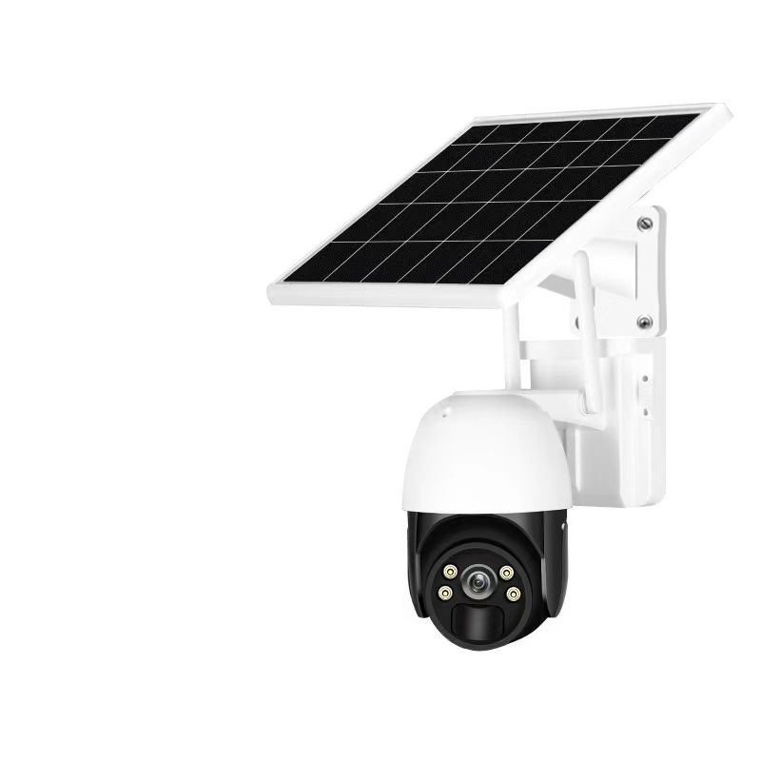

Single-Len Solar-Camera 4G/WiFi
Model | CW19
APPICATION: | Eseecloud
OPERATED SYSTEM: | Android, Apple IOS
RESOLUTION: | 4MP
PIXEL: | 2560*1440
PTZ ANGLE: | 355° PTZ Rotation + 75° Tilt Angle
Internet Connection: | WIFI/4G/5G optional
POWER SUPPLY: | 3.5W Solar Panel
Battery Capacity: | Built-in 8000mah battery
DETECTION MODE: | PIR Human sensing +AI human detection
AUDIO: | Support Two-way Audio(Built-in speaker )
Cloud storage/Local storage: | Support/Support TF SD card (Max 256G)
Night Vision: | Full-Color Night Vision

Slide 3

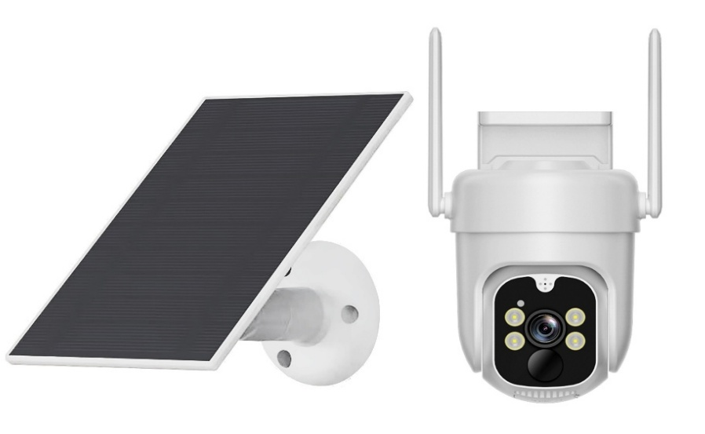

Single Lens Solar-Camera 4G/WiFi
Model | TBG12
APPICATION: | Eseecloud
OPERATED SYSTEM: | Android, Apple IOS
RESOLUTION: | 4MP
PIXEL: | 2560*1440
PTZ ANGLE: | 350° PTZ Rotation + 90° Tilt Angle
Internet Connection: | WIFI/4G/5G optional
POWER SUPPLY: | 3.5W Solar Panel
Battery Capacity: | Built-in 8000mah battery
DETECTION MODE: | PIR Human sensing +AI human detection
AUDIO: | Support Two-way Audio(Built-in speaker )
Cloud storage/Local storage: | Support/Support TF SD card (Max 256G)
Night Vision: | Full-Color Night Vision

Slide 4

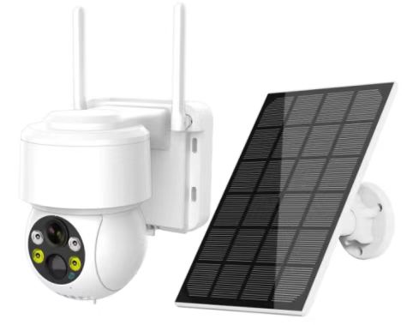

Dual-Lens Solar-Camera 4G/WiFi
Model | TBG13
APPICATION: | Eseecloud
OPERATED SYSTEM: | Android, Apple IOS
RESOLUTION: | 4MP
PIXEL: | 2560*1440
PTZ ANGLE: | 350° PTZ Rotation + 90° Tilt Angle
Internet Connection: | WIFI/4G/5G optional
POWER SUPPLY: | 3W Solar Panel
Battery Capacity: | Built-in 8000mah battery
DETECTION MODE: | PIR Human sensing +AI human detection
AUDIO: | Two-way Audio(Built-in speaker )
Cloud storage/Local storage: | Support/Support TF SD card (Max 256G)
Night Vision: | Full-Color Night Vision

Slide 5

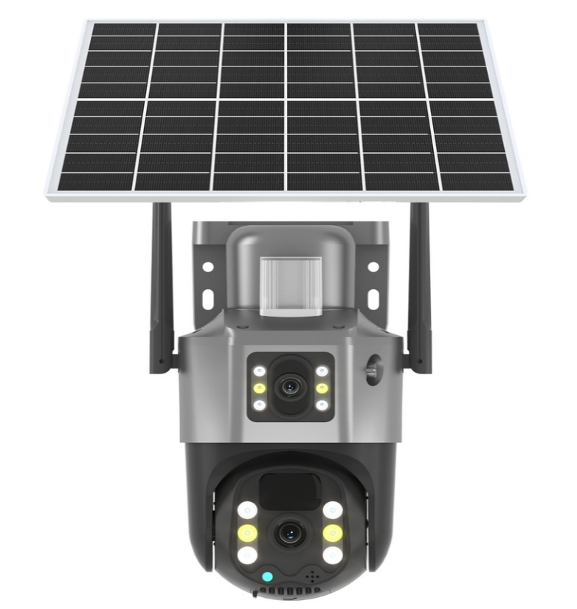
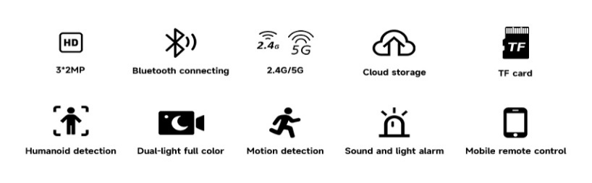
Dual-Lens Solar-Camera 4G/WiFi
Model | BG22128C
APPICATION | Eseecloud
OPERATED SYSTEM | Android, Apple IOS
RESOLUTION | 2MP
PIXEL | 1920×1080
PTZ ANGLE | 350° PTZ Rotation + 90° Tilt Angle
Internet Connection | WIFI/4G/5G optional
POWER SUPPLY | 7W Solar Panel
Battery Capactiy | Built-in 8000mah battery
DETECTION MODE | PIR Human sensing +AI human detection
AUDIO | Support Two-way Audio(Built-in speaker )
Cloud storage/Local storage | Support/Support TF SD card (Max 256G)
Night Vision | Full-Color Night Vision

Slide 6

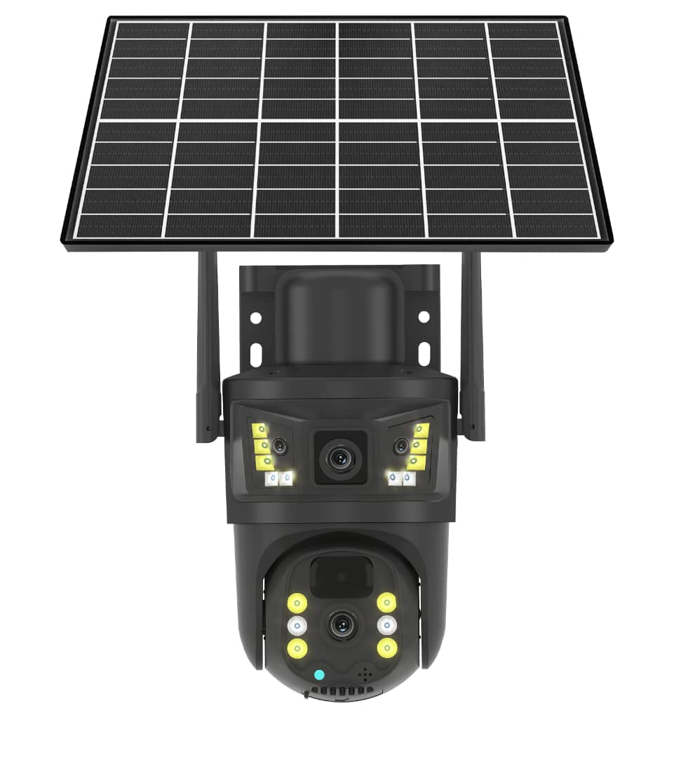
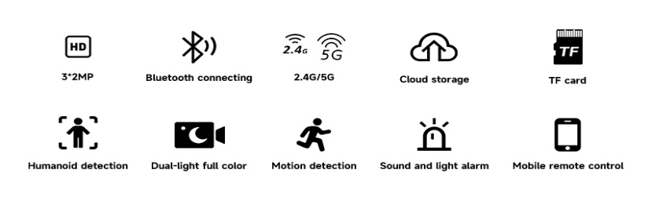
Dual-Lens Solar-Camera 4G/WiFi
Model | BG22082E
APPICATION | Eseecloud
OPERATED SYSTEM | Android, Apple IOS
RESOLUTION | 2MP
PIXEL | 1920×1080
PTZ ANGLE | 350° PTZ Rotation + 90° Tilt Angle
Internet Connection | WIFI/4G/5G optional
POWER SUPPLY | 7W Solar Panel
Battery Capactiy | Built-in 8000mah battery
DETECTION MODE | PIR Human sensing +AI human detection
AUDIO | Support Two-way Audio(Built-in speaker )
Cloud storage/Local storage | Support/Support TF SD card (Max 256G)
Night Vision | Full-Color Night Vision

Slide 7

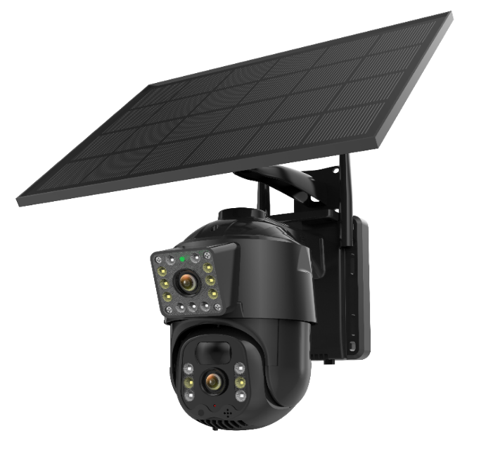

Dual-Lens Solar-Camera 4G/WiFi
Model | TG36
APPICATION | Eseecloud
OPERATED SYSTEM | Android, Apple IOS
RESOLUTION | 2MP
PIXEL | 1920×1080
PTZ ANGLE | 350° PTZ Rotation + 90° Tilt Angle
Internet Connection | WIFI/4G/5G optional
POWER SUPPLY | 6W Solar Panel
Battery Capacity | Built-in 8000mah battery
DETECTION MODE | PIR Human sensing +AI human detection
AUDIO | Support Two-way Audio(Built-in speaker )
Cloud storage/Local storage | Support/Support TF SD card (Max 256G)
Night Vision | Full-Color Night Vision

Slide 8

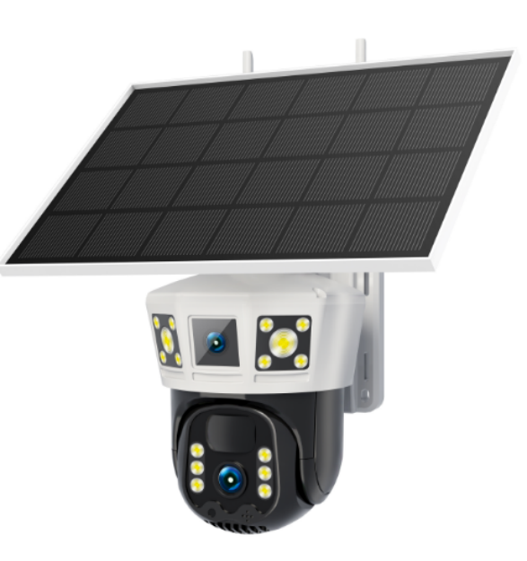

Dual-Lens Solar-Camera 4G/WiFi
Model | TG36PRO
APPICATION | Eseecloud
OPERATED SYSTEM | Android, Apple IOS
RESOLUTION | 3MP+3PM
PIXEL | 2304X2592
PTZ ANGLE | 350° PTZ Rotation + 90° Tilt Angle
Internet Connection | WIFI/4G/5G optional
POWER SUPPLY | 6W Solar Panel
Battery Capacity | Built-in 8000mah battery
DETECTION MODE | PIR Human sensing +AI human detection
AUDIO | Support Two-way Audio(Built-in speaker )
Cloud storage/Local storage | Support/Support TF SD card (Max 256G)
Night Vision | Full-Color Night Vision

Slide 9

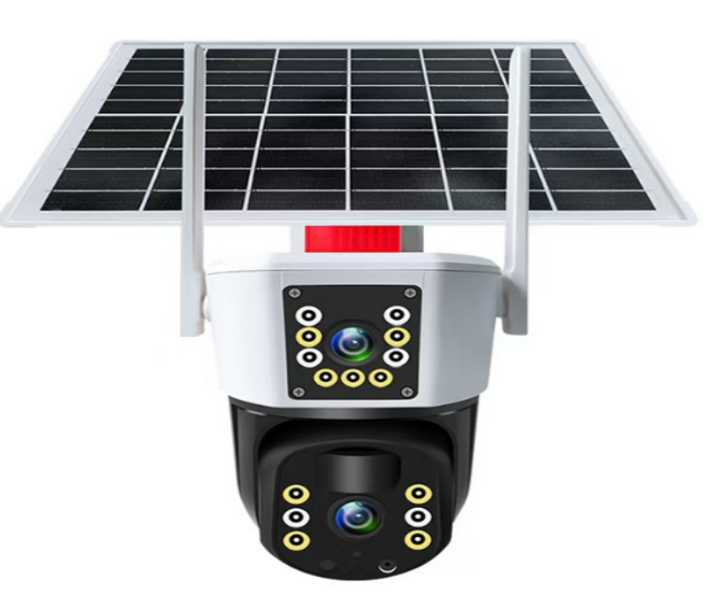

Dual-Lens Solar-Camera 4G/WiFi
Model | TG37
APPICATION | Eseecloud
OPERATED SYSTEM | Android, Apple IOS
RESOLUTION | 2MP
PIXEL | 1920×1080
PTZ ANGLE | 350° PTZ Rotation + 90° Tilt Angle
Internet Connection | WIFI/4G/5G optional
POWER SUPPLY | 6W Solar Panel
Battery Capactiy | Built-in 8000mah battery
DETECTION MODE | PIR Human sensing +AI human detection
AUDIO | Support Two-way Audio(Built-in speaker )
Cloud storage/Local storage | Support/Support TF SD card (Max 256G)
Night Vision | Full-Color Night Vision

Slide 10

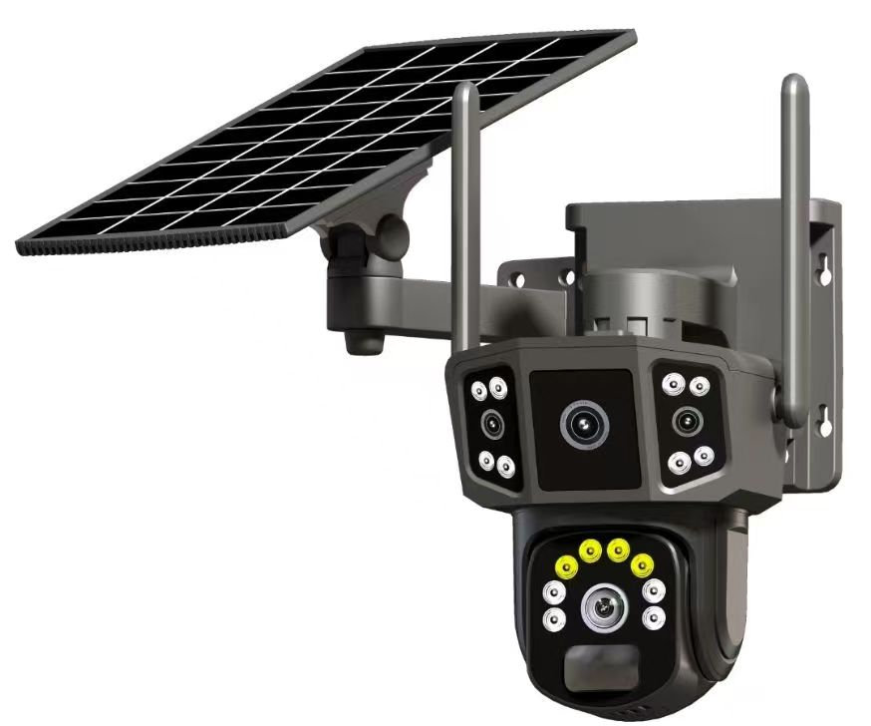

Dual-Lens Solar-Camera 4G/WiFi
Model | TBG18
APPICATION | Eseecloud
OPERATED SYSTEM | Android, Apple IOS
RESOLUTION | 3MP+3PM
PIXEL | 2304X2592
PTZ ANGLE | 350° PTZ Rotation + 90° Tilt Angle
Internet Connection | WIFI/4G/5G optional
POWER SUPPLY | 6W Solar Panel
Battery Capactiy | Built-in 8000mah battery
DETECTION MODE | PIR Human sensing +AI human detection
AUDIO | Support Two-way Audio(Built-in speaker )
Cloud storage/Local storage | Support/Support TF SD card (Max 256G)
Night Vision | Full-Color Night Vision

Slide 11
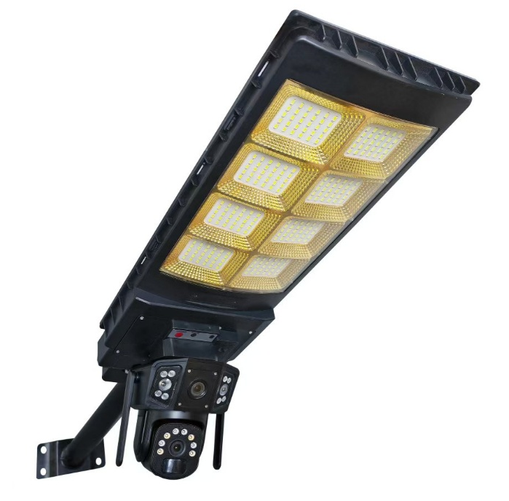

Dual-Lens Solar-Camera with Light 4G/WiFi
Model | TBG18D
APPICATION | Eseecloud
OPERATED SYSTEM | Android, Apple IOS
RESOLUTION | 3MP+3PM
PIXEL | 2304X2592
PTZ ANGLE | 350° PTZ Rotation + 90° Tilt Angle
Internet Connection | WIFI/4G/5G optional
POWER SUPPLY | 6W Solar Panel
Battery Capactiy | Built-in 8000mah battery
DETECTION MODE | PIR Human sensing +AI human detection
AUDIO | Support Two-way Audio(Built-in speaker )
Cloud storage/Local storage | Support/Support TF SD card (Max 256G)
Night Vision | Full-Color Night Vision

Slide 12
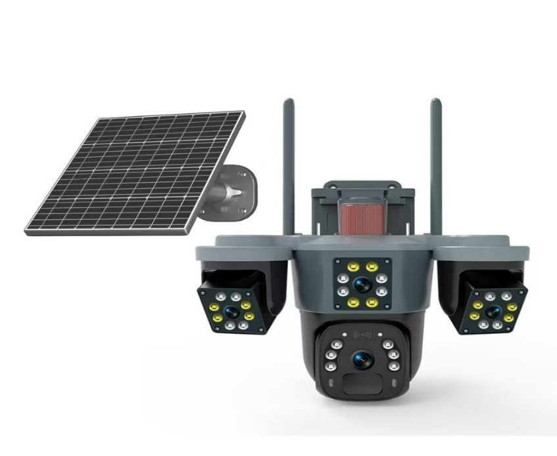

6MP Triple Lens Solar-Camera 4G/WiFi
Model | BG23116A
APPICATION | Eseecloud
OPERATED SYSTEM | Android, Apple IOS
RESOLUTION | 3MP+3PM+3PM
PIXEL | 1920×3240
PTZ ANGLE | 350° PTZ Rotation + 90° Tilt Angle
Internet Connection | WIFI/4G/5G optional
POWER SUPPLY | 6W Solar Panel
Battery Capactiy | Built-in 8000mah battery
DETECTION MODE | PIR Human sensing +AI human detection
AUDIO | Support Two-way Audio(Built-in speaker )
Cloud storage/Local storage | Support/Support TF SD card (Max 256G)
Night Vision | Full-Color Night Vision

Slide 13
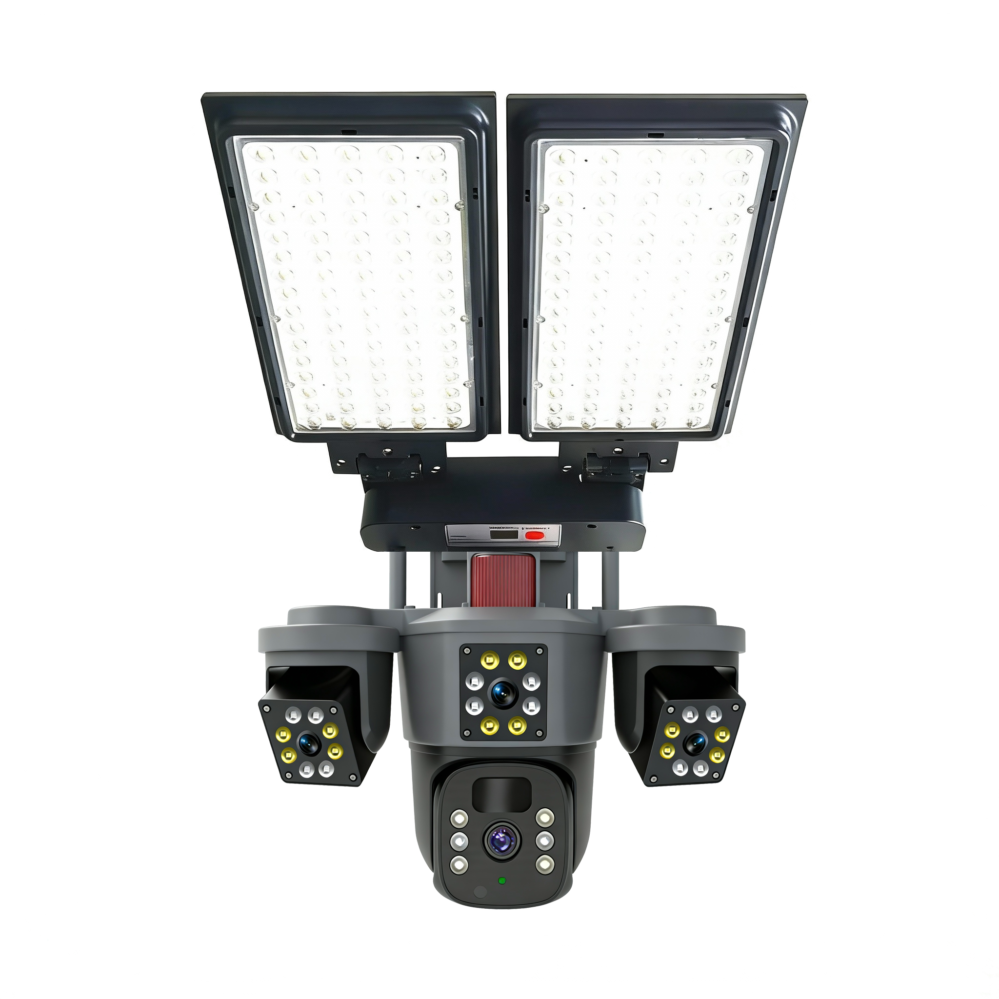
6MP Triple Lens Solar-Camera 4G/WiFi
Model | solar street light camera
APPICATION | Eseecloud
OPERATED SYSTEM | Android, Apple IOS
RESOLUTION | 3MP+3PM+3PM
PIXEL | 1920×3240
PTZ ANGLE | 350° PTZ Rotation + 90° Tilt Angle
Internet Connection | WIFI/4G/5G optional
POWER SUPPLY | 18W Solar Panel
Battery Capactiy | Built-in 12000mah battery
DETECTION MODE | PIR Human sensing +AI human detection
AUDIO | Support Two-way Audio(Built-in speaker )
Cloud storage/Local storage | Support/Support TF SD card (Max 256G)
Night Vision | Full-Color Night Vision

Slide 14
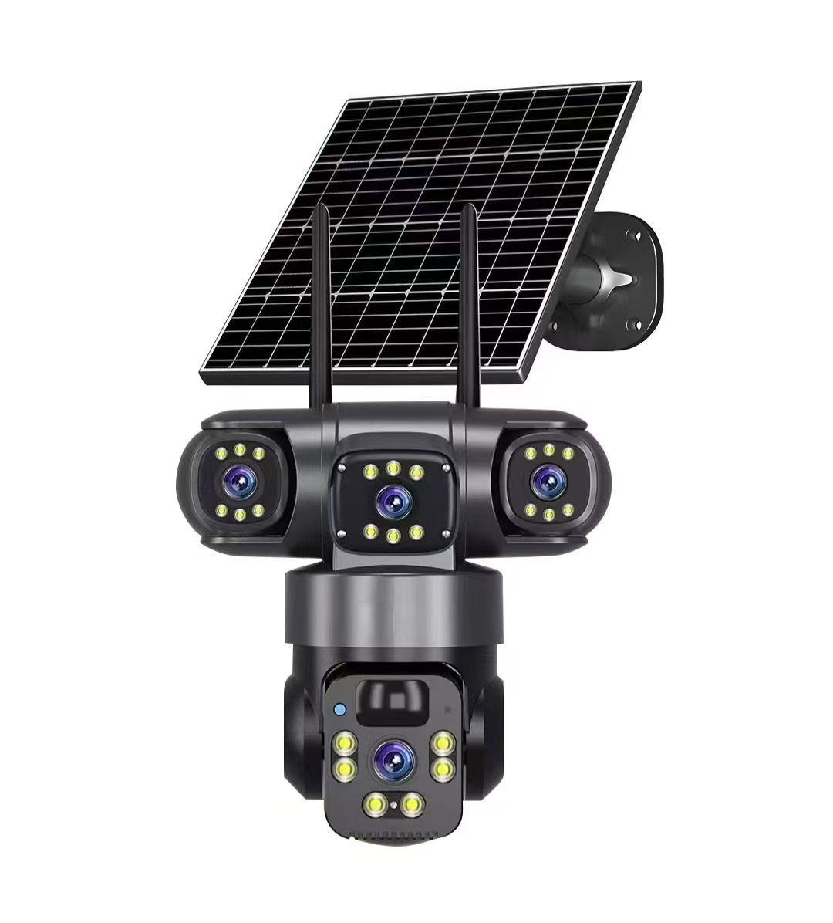

3MP Triple Lens Solar-Camera 4G/WiFi
Model | BG23132D
APPICATION | Eseecloud
OPERATED SYSTEM | Android, Apple IOS
RESOLUTION | 3MP+3PM+3PM
PIXEL | 1920×3240
PTZ ANGLE | 350° PTZ Rotation + 90° Tilt Angle
Internet Connection | WIFI/4G/5G optional
POWER SUPPLY | 6W Solar Panel
Battery Capactiy | Built-in 8000mah battery
DETECTION MODE | PIR Human sensing +AI human detection
AUDIO | Support Two-way Audio(Built-in speaker )
Cloud storage/Local storage | Support/Support TF SD card (Max 256G)
Night Vision | Full-Color Night Vision

Slide 15
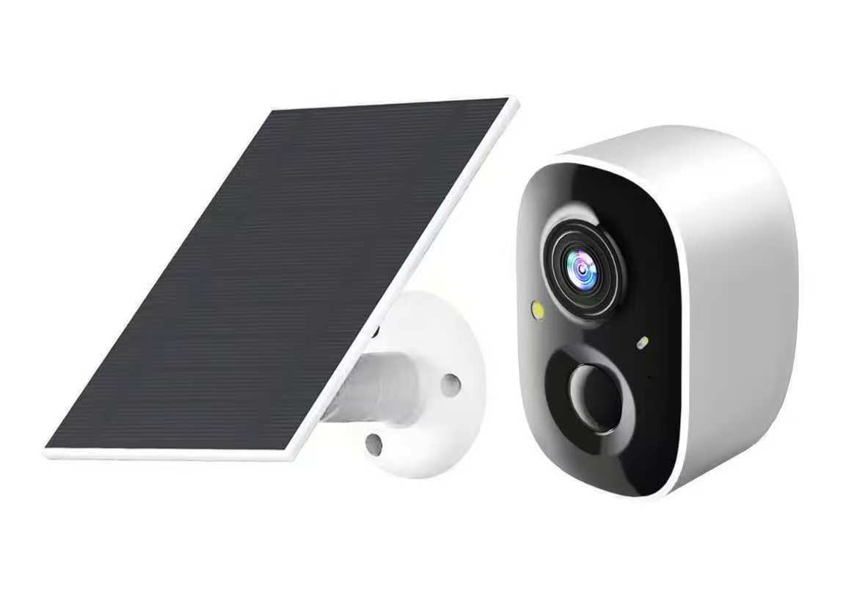

Dual-Lens Solar-Camera 4G/WiFi
Model | M8
APPICATION | Eseecloud
OPERATED SYSTEM | Android, Apple IOS
RESOLUTION | 4MP
PIXEL | 2560X1440
PTZ ANGLE | 350° PTZ Rotation + 90° Tilt Angle
Internet Connection | WIFI/4G/5G optional
POWER SUPPLY | 3W Solar Panel
Battery Capactiy | Built-in 8000mah battery
DETECTION MODE | PIR Human sensing +AI human detection
AUDIO | Support Two-way Audio(Built-in speaker )
Cloud storage/Local storage | Support/Support TF SD card (Max 256G)
Night Vision | Full-Color Night Vision

Slide 16

Indoor Cameras Series

Slide 17
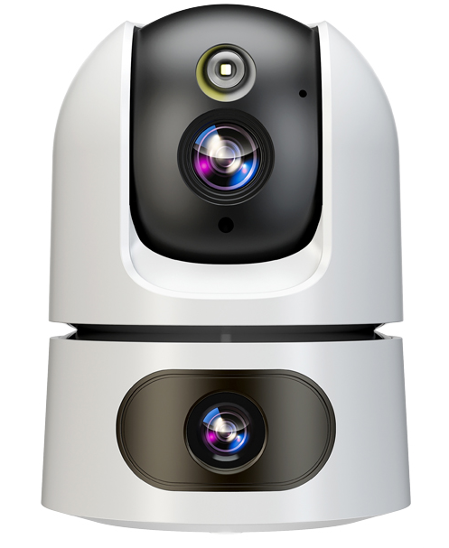

Dual-Lens Indoor-Camera 4G/WiFi
Model | MWA07
APPICATION | Eseecloud
OPERATED SYSTEM | Android, Apple IOS
RESOLUTION | 2MP+2MP
PIXEL | 1920X2160
PTZ ANGLE | 350° PTZ Rotation + 90° Tilt Angle
Internet Connection | WIFI/4G/5G optional
POWER SUPPLY | DC 5V
Battery Capactiy | NONE
DETECTION MODE | PIR Human sensing +AI human detection
AUDIO | Support Two-way Audio(Built-in speaker )
Cloud storage/Local storage | Support/Support TF SD card (Max 256G)
Night Vision | Full-Color Night Vision

Slide 18
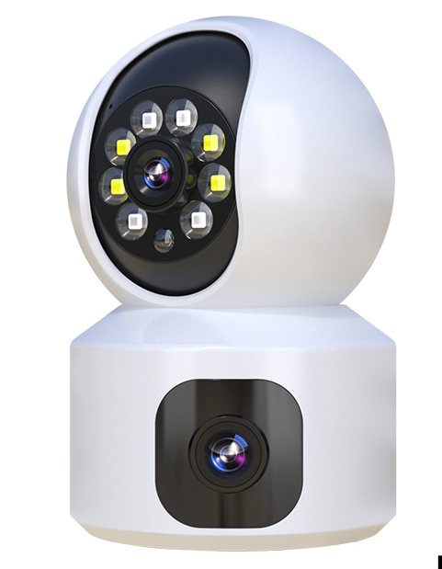

Dual-Lens Indoor-Camera 4G/WiFi
Model | MG10
APPICATION | Eseecloud
OPERATED SYSTEM | Android, Apple IOS
RESOLUTION | 2MP+2MP
PIXEL | 1920X2160
PTZ ANGLE | 350° PTZ Rotation + 90° Tilt Angle
Internet Connection | WIFI/4G/5G optional
POWER SUPPLY | DC 5V
Battery Capactiy | NONE
DETECTION MODE | PIR Human sensing +AI human detection
AUDIO | Support Two-way Audio(Built-in speaker )
Cloud storage/Local storage | Support/Support TF SD card (Max 256G)
Night Vision | Full-Color Night Vision

Slide 19
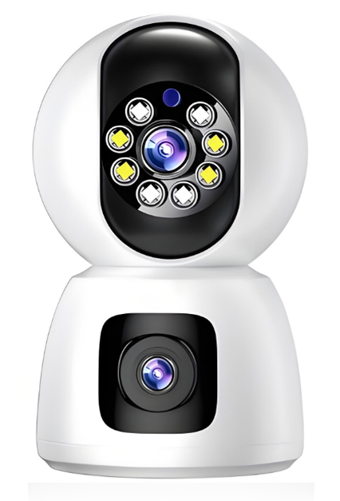

Dual-Lens Indoor-Camera 4G/WiFi
Model | MG11
APPICATION | Eseecloud
OPERATED SYSTEM | Android, Apple IOS
RESOLUTION | 2MP+2MP
PIXEL | 1920X2160
PTZ ANGLE | 350° PTZ Rotation + 90° Tilt Angle
Internet Connection | WIFI/4G/5G optional
POWER SUPPLY | DC 5V
Battery Capactiy | NONE
DETECTION MODE | PIR Human sensing +AI human detection
AUDIO | Support Two-way Audio(Built-in speaker )
Cloud storage/Local storage | Support/Support TF SD card (Max 256G)
Night Vision | Full-Color Night Vision

Slide 20

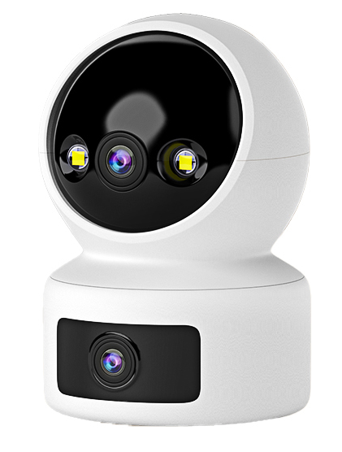

Dual-Lens Indoor-Camera 4G/WiFi
Model | MG04
APPICATION | Eseecloud
OPERATED SYSTEM | Android, Apple IOS
RESOLUTION | 2MP
PIXEL | 1920X2160
PTZ ANGLE | 350° PTZ Rotation + 90° Tilt Angle
Internet Connection | WIFI/4G/5G optional
POWER SUPPLY | DC 5V
Battery Capactiy | NONE
DETECTION MODE | PIR Human sensing +AI human detection
AUDIO | Support Two-way Audio(Built-in speaker )
Cloud storage/Local storage | Support/Support TF SD card (Max 256G)
Night Vision | Full-Color Night Vision

Slide 21
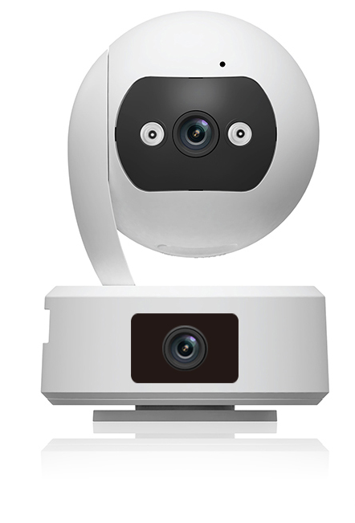

Dual Lens Indoor-Camera 4G/WiFi
Model | MG12
APPICATION | Eseecloud
OPERATED SYSTEM | Android, Apple IOS
RESOLUTION | 2MP
PIXEL | 1920X2160
PTZ ANGLE | 350° PTZ Rotation + 90° Tilt Angle
Internet Connection | WIFI/4G/5G optional
POWER SUPPLY | DC 5V
Battery Capactiy | NONE
DETECTION MODE | PIR Human sensing +AI human detection
AUDIO | Support Two-way Audio(Built-in speaker )
Cloud storage/Local storage | Support/Support TF SD card (Max 256G)
Night Vision | Full-Color Night Vision

Slide 22
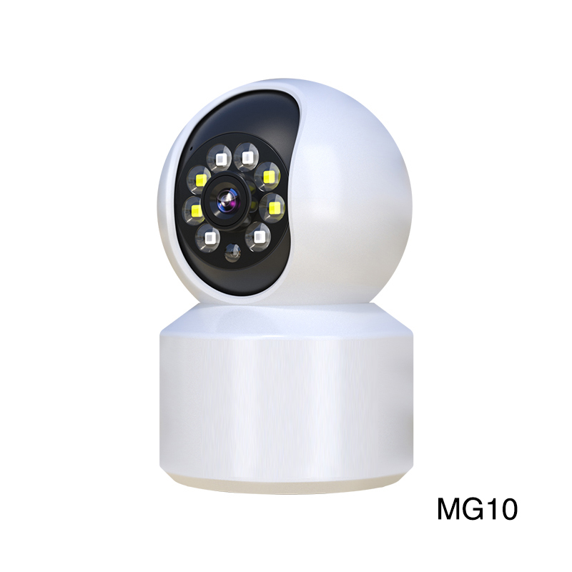

Single Lens Indoor-Camera 4G/WiFi
Model | MG10
APPICATION | Eseecloud
OPERATED SYSTEM | Android, Apple IOS
RESOLUTION | 2MP
PIXEL | 1920X1080
PTZ ANGLE | 350° PTZ Rotation + 90° Tilt Angle
Internet Connection | WIFI/4G/5G optional
POWER SUPPLY | DC 5V
Battery Capactiy | NONE
DETECTION MODE | PIR Human sensing +AI human detection
AUDIO | Support Two-way Audio(Built-in speaker )
Cloud storage/Local storage | Support/Support TF SD card (Max 256G)
Night Vision | Full-Color Night Vision

Slide 23
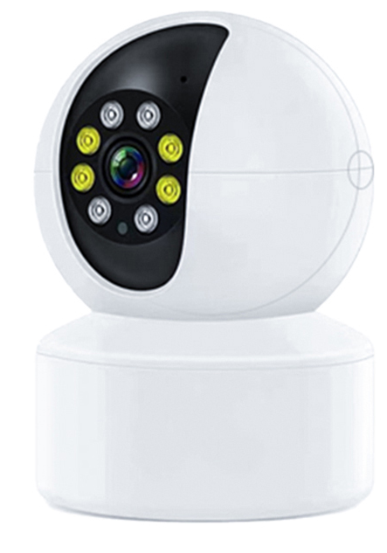

Single Lens Indoor-Camera 4G/WiFi
Model | MG09
APPICATION | Eseecloud
OPERATED SYSTEM | Android, Apple IOS
RESOLUTION | 2MP
PIXEL | 1920X1080
PTZ ANGLE | 350° PTZ Rotation + 90° Tilt Angle
Internet Connection | WIFI/4G/5G optional
POWER SUPPLY | DC 5V
Battery Capacity | NONE
DETECTION MODE | PIR Human sensing +AI human detection
AUDIO | Support Two-way Audio(Built-in speaker )
Cloud storage/Local storage | Support/Support TF SD card (Max 256G)
Night Vision | Full-Color Night Vision

Slide 24
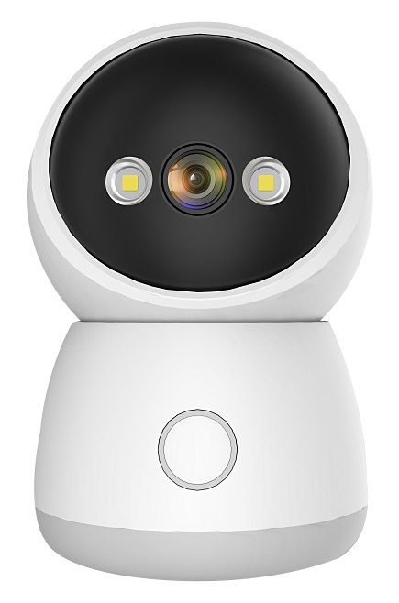

Single Lens Indoor-Camera 4G/WiFi
Model | MW02
APPICATION | Eseecloud
OPERATED SYSTEM | Android, Apple IOS
RESOLUTION | 2MP
PIXEL | 1920X1080
PTZ ANGLE | 350° PTZ Rotation + 90° Tilt Angle
Internet Connection | WIFI/4G/5G optional
POWER SUPPLY | DC 5V
Battery Capactiy | NONE
DETECTION MODE | PIR Human sensing +AI human detection
AUDIO | Support Two-way Audio(Built-in speaker )
Cloud storage/Local storage | Support/Support TF SD card (Max 256G)
Night Vision | Full-Color Night Vision

Slide 25
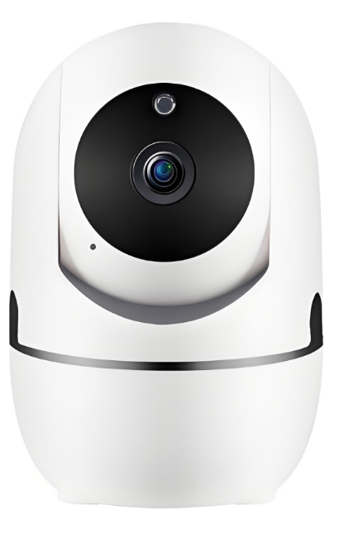

Single Lens Indoor-Camera 4G/WiFi
Model | MW06
APPICATION | Eseecloud
OPERATED SYSTEM | Android, Apple IOS
RESOLUTION | 2MP
PIXEL | 1920X1080
PTZ ANGLE | 350° PTZ Rotation + 90° Tilt Angle
Internet Connection | WIFI/4G/5G optional
POWER SUPPLY | DC 5V
Battery Capactiy | Built-in 8000mah battery
DETECTION MODE | PIR Human sensing +AI human detection
AUDIO | Support Two-way Audio(Built-in speaker )
Cloud storage/Local storage | Support/Support TF SD card (Max 256G)
Night Vision | Full-Color Night Vision

Slide 26

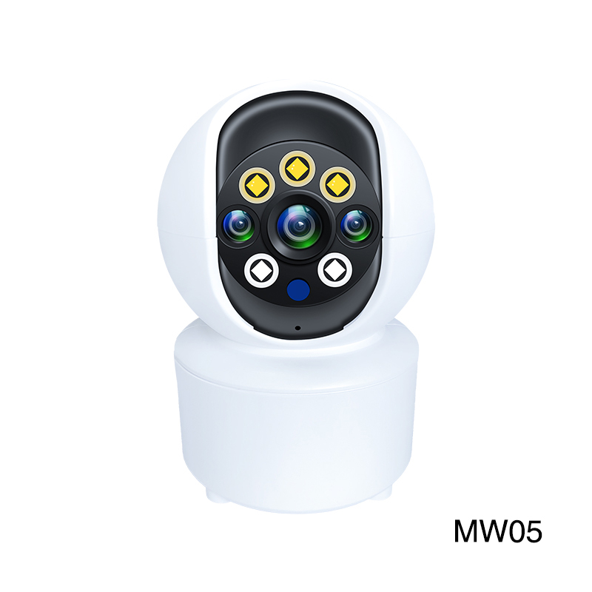

Single-Len Indoor-Camera 4G/WiFi
Model | MW05
APPICATION | Eseecloud
OPERATED SYSTEM | Android, Apple IOS
RESOLUTION | 2MP
PIXEL | 1920X1080
PTZ ANGLE | 350° PTZ Rotation + 90° Tilt Angle
Internet Connection | WIFI/4G/5G optional
POWER SUPPLY | DC 5V
Battery Capactiy | NONE
DETECTION MODE | PIR Human sensing +AI human detection
AUDIO | Support Two-way Audio(Built-in speaker )
Cloud storage/Local storage | Support/Support TF SD card (Max 256G)
Night Vision | Full-Color Night Vision

Slide 27
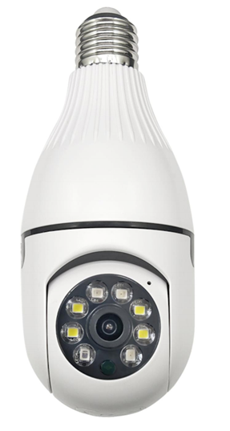
Single Lens Indoor-Camera 4G/WiFi
Model | E1
APPICATION | Eseecloud
OPERATED SYSTEM | Android, Apple IOS
RESOLUTION | 2MP
PIXEL | 1920X1080
PTZ ANGLE | 350° PTZ Rotation + 90° Tilt Angle
Internet Connection | WIFI/4G/5G optional
POWER SUPPLY | DC 5V
Battery Capactiy | NONE
DETECTION MODE | PIR Human sensing +AI human detection
AUDIO | Support Two-way Audio(Built-in speaker )
Cloud storage/Local storage | Support/Support TF SD card (Max 256G)
Night Vision | Full-Color Night Vision

Slide 28
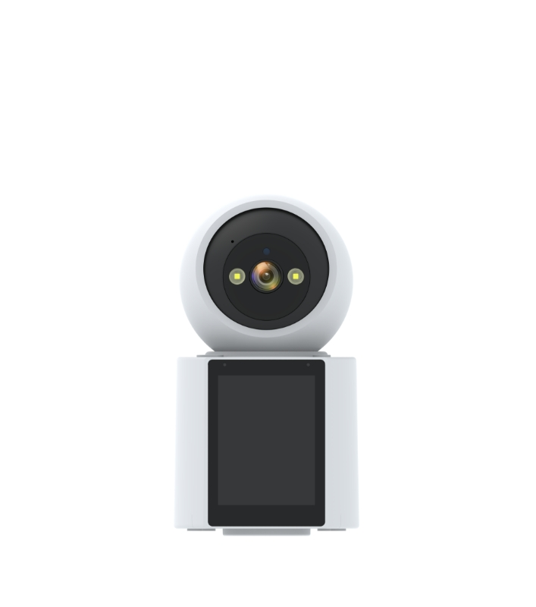

Single Lens Indoor-Camera 4G/WiFi
Model | MDG01B
APPICATION | Eseecloud
OPERATED SYSTEM | Android, Apple IOS
RESOLUTION | 2MP
PIXEL | 1920X1080
PTZ ANGLE | 350° PTZ Rotation + 90° Tilt Angle
Internet Connection | WIFI/4G/5G optional
POWER SUPPLY | DC 5V
Battery Capactiy | NONE
DETECTION MODE | PIR Human sensing +AI human detection
AUDIO | Support Two-way Audio(Built-in speaker )
Cloud storage/Local storage | Support/Support TF SD card (Max 256G)
Night Vision | Full-Color Night Vision

Slide 29
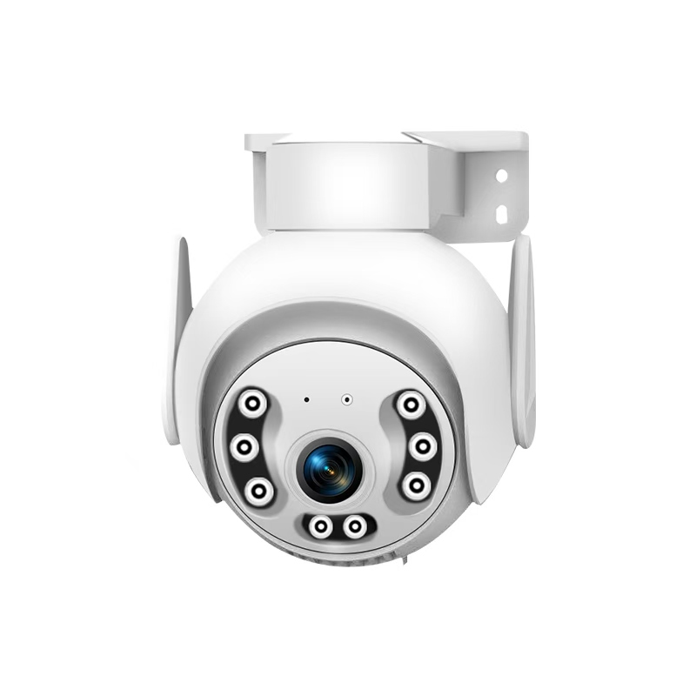

Single Lens Indoor-Camera 4G/WiFi
Model | CW21137A
APPICATION | Eseecloud
OPERATED SYSTEM | Android, Apple IOS
RESOLUTION | 2MP
PIXEL | 1920X1080
PTZ ANGLE | 350° PTZ Rotation + 90° Tilt Angle
Internet Connection | WIFI/4G/5G optional
POWER SUPPLY | DC 5V
Battery Capactiy | NONE
DETECTION MODE | PIR Human sensing +AI human detection
AUDIO | Support Two-way Audio(Built-in speaker )
Cloud storage/Local storage | Support/Support TF SD card (Max 256G)
Night Vision | Full-Color Night Vision

Slide 30
AC-Power Cameras Series

Slide 31
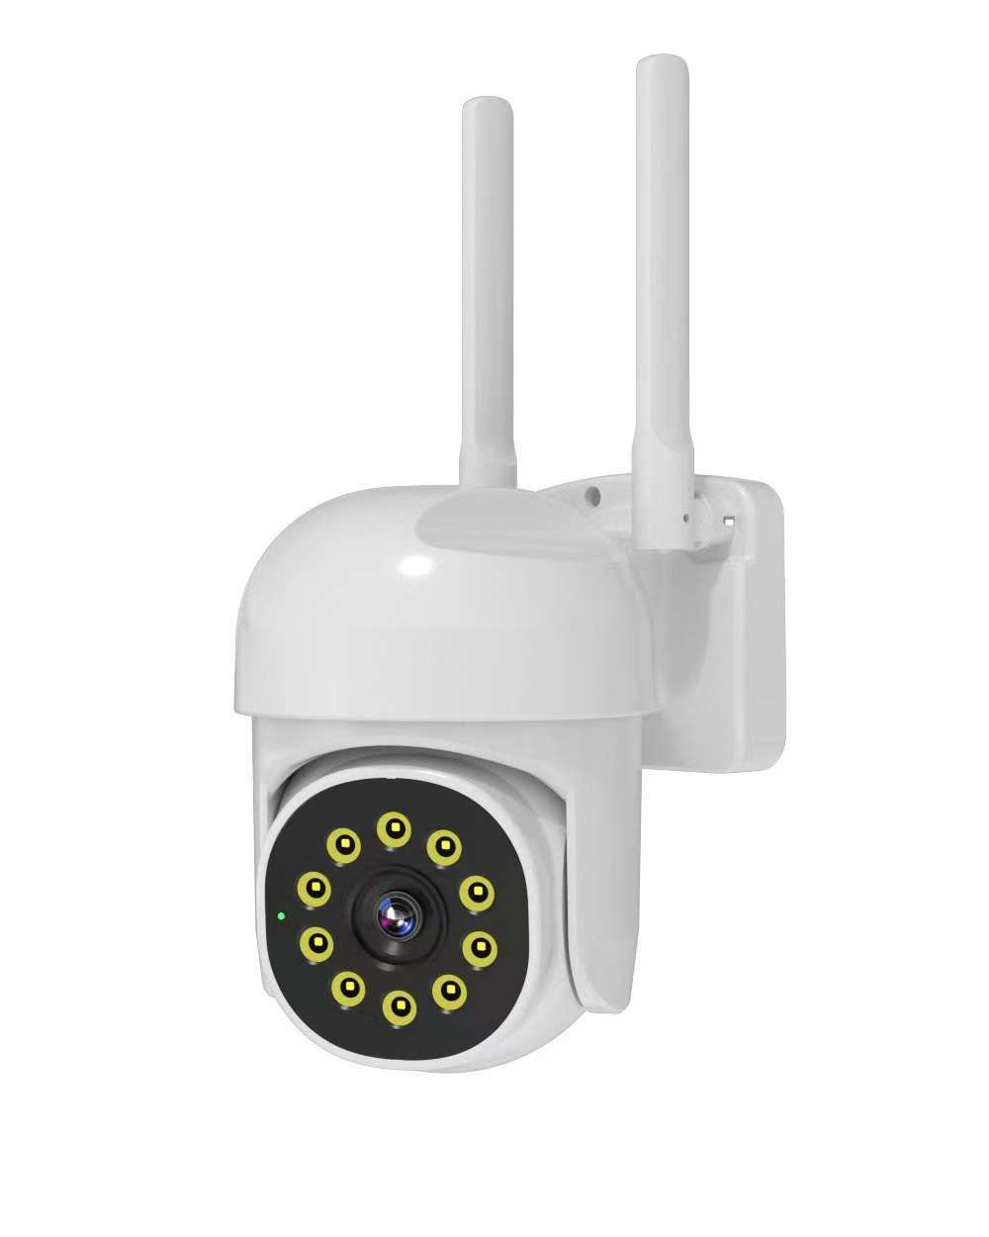

Dual Lens outdoor-Camera 4G/WiFi
Model | CW53
APPICATION | Eseecloud
OPERATED SYSTEM | Android, Apple IOS
RESOLUTION | 3PM
PIXEL | 2304X1296
PTZ ANGLE | 350° PTZ Rotation + 90° Tilt Angle
Internet Connection | WIFI/4G/5G optional
POWER SUPPLY | DC 5V
Battery Capacity | NONE
DETECTION MODE | PIR Human sensing +AI human detection
AUDIO | Support Two-way Audio(Built-in speaker )
Cloud storage/Local storage | Support/Support TF SD card (Max 256G)
Night Vision | Full-Color Night Vision

Slide 32
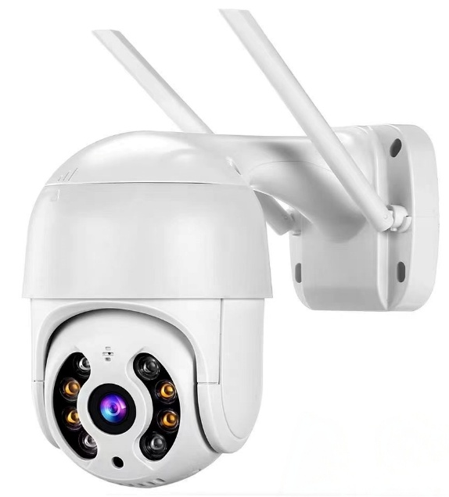

Dual Lens outdoor-Camera 4G/WiFi
Model | CW21060A
APPICATION | Eseecloud
OPERATED SYSTEM | Android, Apple IOS
RESOLUTION | 2PM
PIXEL | 1920X2160
PTZ ANGLE | 350° PTZ Rotation + 90° Tilt Angle
Internet Connection | WIFI/4G/5G optional
POWER SUPPLY | DC 5V
Battery Capacity | NONE
DETECTION MODE | PIR Human sensing +AI human detection
AUDIO | Support Two-way Audio(Built-in speaker )
Cloud storage/Local storage | Support/Support TF SD card (Max 256G)
Night Vision | Full-Color Night Vision

Slide 33
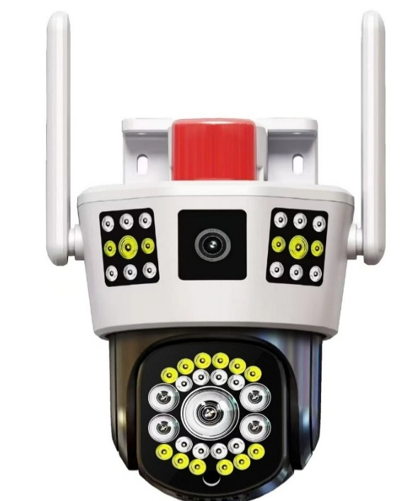

Dual Lens outdoor-Camera 4G/WiFi
Model | JW51/JG51
APPICATION | Eseecloud
OPERATED SYSTEM | Android, Apple IOS
RESOLUTION | 2MP+2PM
PIXEL | 1920X2160
PTZ ANGLE | 350° PTZ Rotation + 90° Tilt Angle
Internet Connection | WIFI/4G/5G optional
POWER SUPPLY | DC 12V
Battery Capactiy | NONE
DETECTION MODE | PIR Human sensing +AI human detection
AUDIO | Support Two-way Audio(Built-in speaker )
Cloud storage/Local storage | Support/Support TF SD card (Max 256G)
Night Vision | Full-Color Night Vision

Slide 34
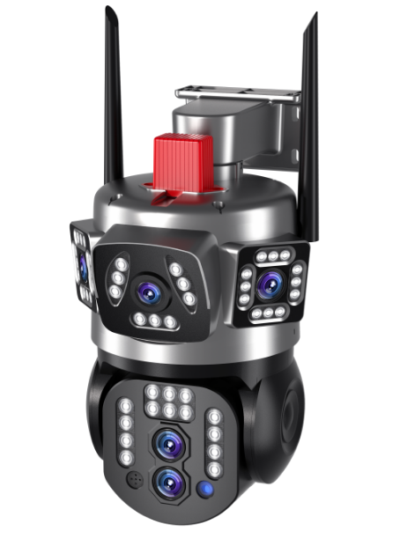

Dual Lens outdoor-Camera 4G/WiFi
Model | JW53/JG53
APPICATION | Eseecloud
OPERATED SYSTEM | Android, Apple IOS
RESOLUTION | 2MP+2PM
PIXEL | 1920X2160
PTZ ANGLE | 350° PTZ Rotation + 90° Tilt Angle
Internet Connection | WIFI/4G/5G optional
POWER SUPPLY | DC 12V
Battery Capactiy | Built-in 8000mah battery
DETECTION MODE | PIR Human sensing +AI human detection
AUDIO | Support Two-way Audio(Built-in speaker )
Cloud storage/Local storage | Support/Support TF SD card (Max 256G)
Night Vision | Full-Color Night Vision

Slide 35
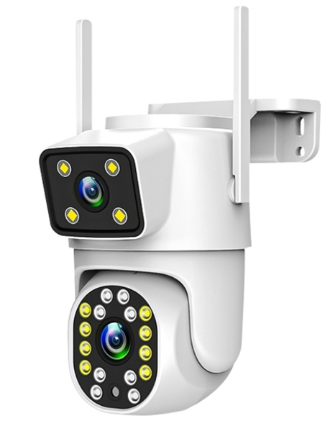

Dual Lens outdoor-Camera 4G/WiFi
Model | JW46B/JG46B
APPICATION | Eseecloud
OPERATED SYSTEM | Android, Apple IOS
RESOLUTION | 2MP+2PM
PIXEL | 1920X2160
PTZ ANGLE | 350° PTZ Rotation + 90° Tilt Angle
Internet Connection | WIFI/4G/5G optional
POWER SUPPLY | DC 5V
Battery Capactiy | Built-in 8000mah battery
DETECTION MODE | PIR Human sensing +AI human detection
AUDIO | Support Two-way Audio(Built-in speaker )
Cloud storage/Local storage | Support/Support TF SD card (Max 256G)
Night Vision | Full-Color Night Vision

Slide 36
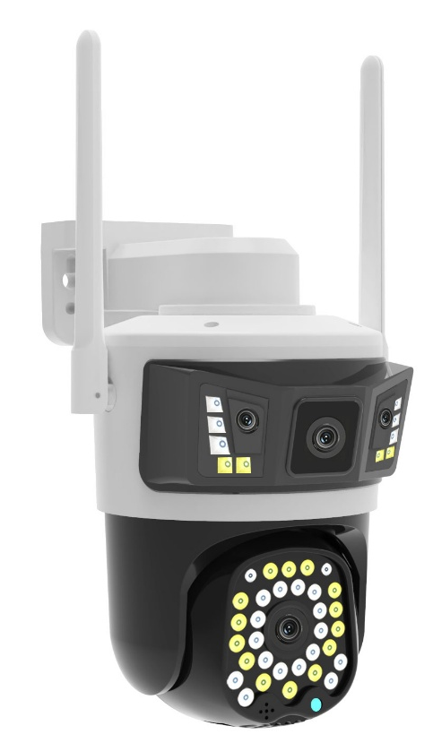
Dual Lens outdoor-Camera 4G/WiFi
Model | CW22082/CG22082
APPICATION | Eseecloud
OPERATED SYSTEM | Android, Apple IOS
RESOLUTION | 2MP+2PM
PIXEL | 1920X2160
PTZ ANGLE | 350° PTZ Rotation + 90° Tilt Angle
Internet Connection | WIFI/4G/5G optional
POWER SUPPLY | DC 5V
Battery Capactiy | Built-in 8000mah battery
DETECTION MODE | PIR Human sensing +AI human detection
AUDIO | Support Two-way Audio(Built-in speaker )
Cloud storage/Local storage | Support/Support TF SD card (Max 256G)
Night Vision | Full-Color Night Vision

Slide 37
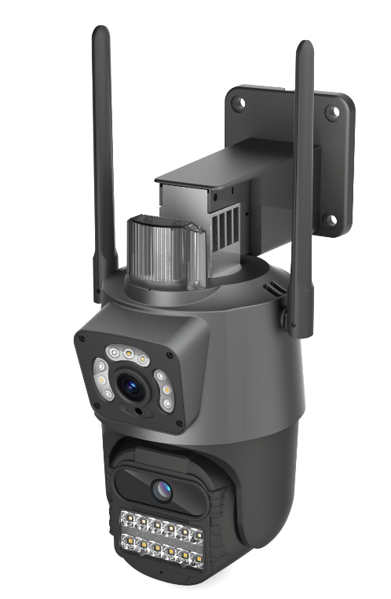
Dual-Lens outdoor-Camera 4G/WiFi
Model | PW11
APPICATION | Eseecloud
OPERATED SYSTEM | Android, Apple IOS
RESOLUTION | 2MP+2PM
PIXEL | 1920X2160
PTZ ANGLE | 350° PTZ Rotation + 90° Tilt Angle
Internet Connection | WIFI/4G/5G optional
POWER SUPPLY | DC 5V
Battery Capactiy | Built-in 8000mah battery
DETECTION MODE | PIR Human sensing +AI human detection
AUDIO | Support Two-way Audio(Built-in speaker )
Cloud storage/Local storage | Support/Support TF SD card (Max 256G)
Night Vision | Full-Color Night Vision

Slide 38
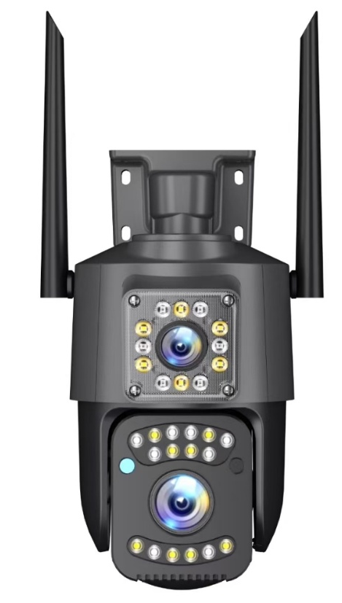
Dual-Lens outdoor-Camera 4G/WiFi
Model | PW11 小号
APPICATION | Eseecloud
OPERATED SYSTEM | Android, Apple IOS
RESOLUTION | 2MP+2PM
PIXEL | 1920X2160
PTZ ANGLE | 350° PTZ Rotation + 90° Tilt Angle
Internet Connection | WIFI/4G/5G optional
POWER SUPPLY | DC 5V
Battery Capactiy | Built-in 8000mah battery
DETECTION MODE | PIR Human sensing +AI human detection
AUDIO | Support Two-way Audio(Built-in speaker )
Cloud storage/Local storage | Support/Support TF SD card (Max 256G)
Night Vision | Full-Color Night Vision

Slide 39
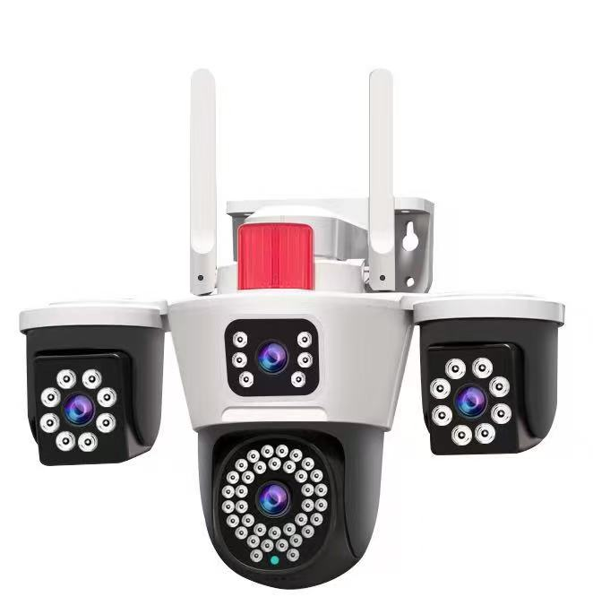

Triple Lens outdoor-Camera 4G/WiFi
Model | CG23030A/CW23030A
APPICATION | Eseecloud
OPERATED SYSTEM | Android, Apple IOS
RESOLUTION | 2MP+2PM+2PM
PIXEL | 1920X3240
PTZ ANGLE | 350° PTZ Rotation + 90° Tilt Angle
Internet Connection | WIFI/4G/5G optional
POWER SUPPLY | DC 12V
Battery Capactiy | NONE
DETECTION MODE | PIR Human sensing +AI human detection
AUDIO | Support Two-way Audio(Built-in speaker )
Cloud storage/Local storage | Support/Support TF SD card (Max 256G)
Night Vision | Full-Color Night Vision

Slide 40
HD NVR KITS

Slide 41
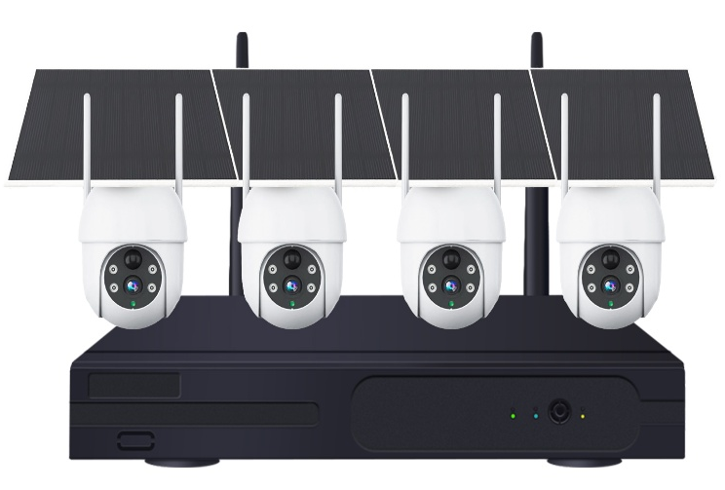
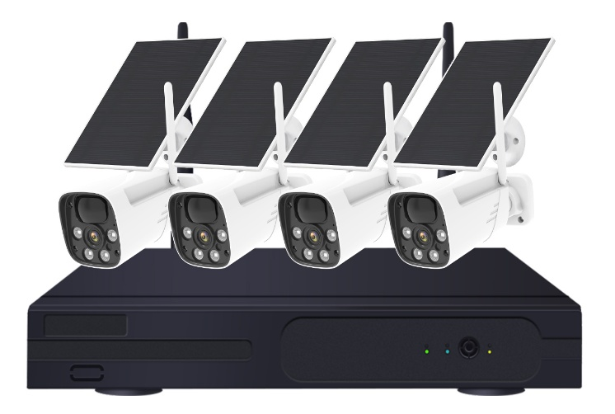
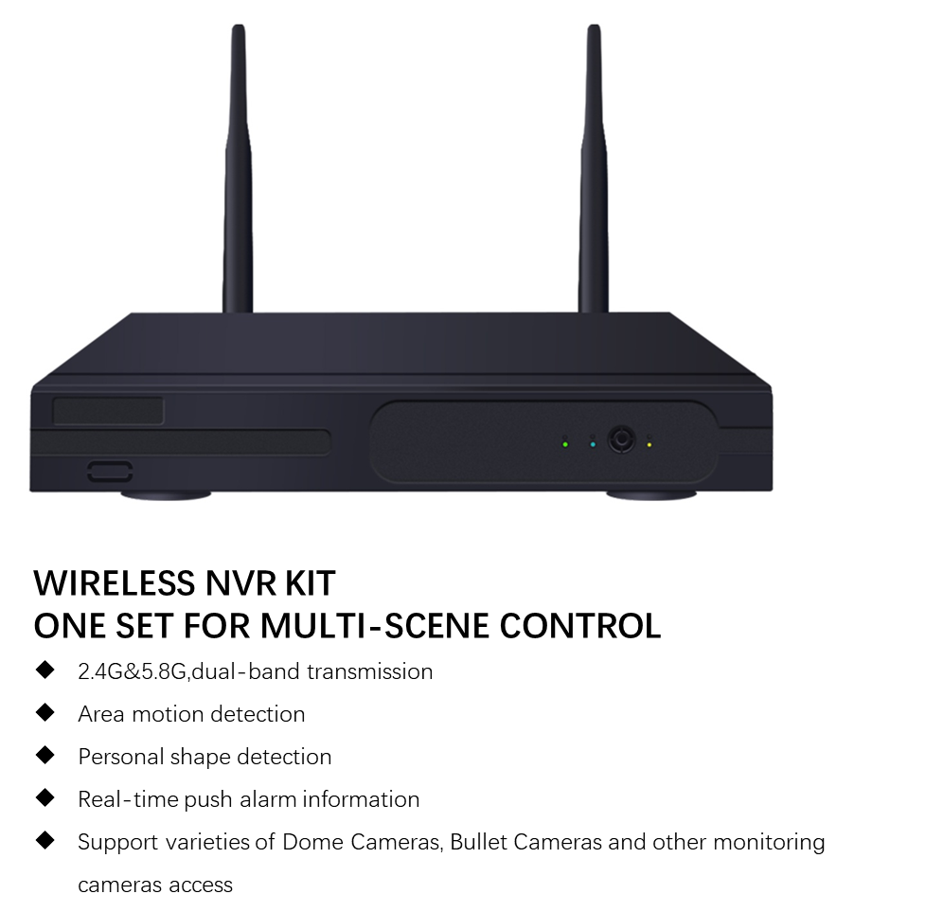
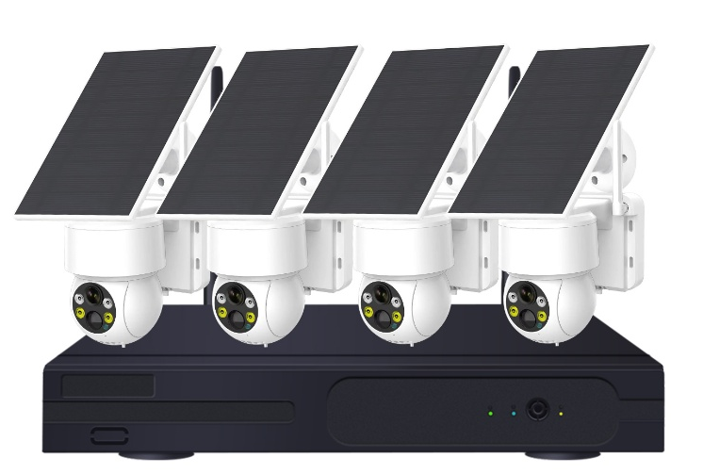
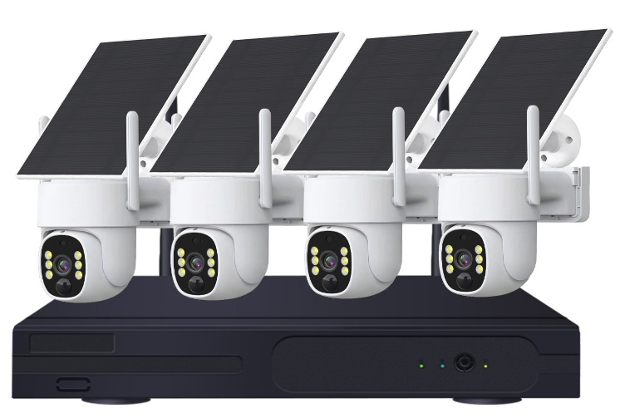

Slide 42
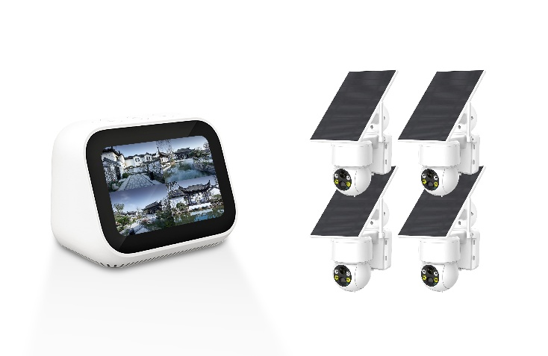
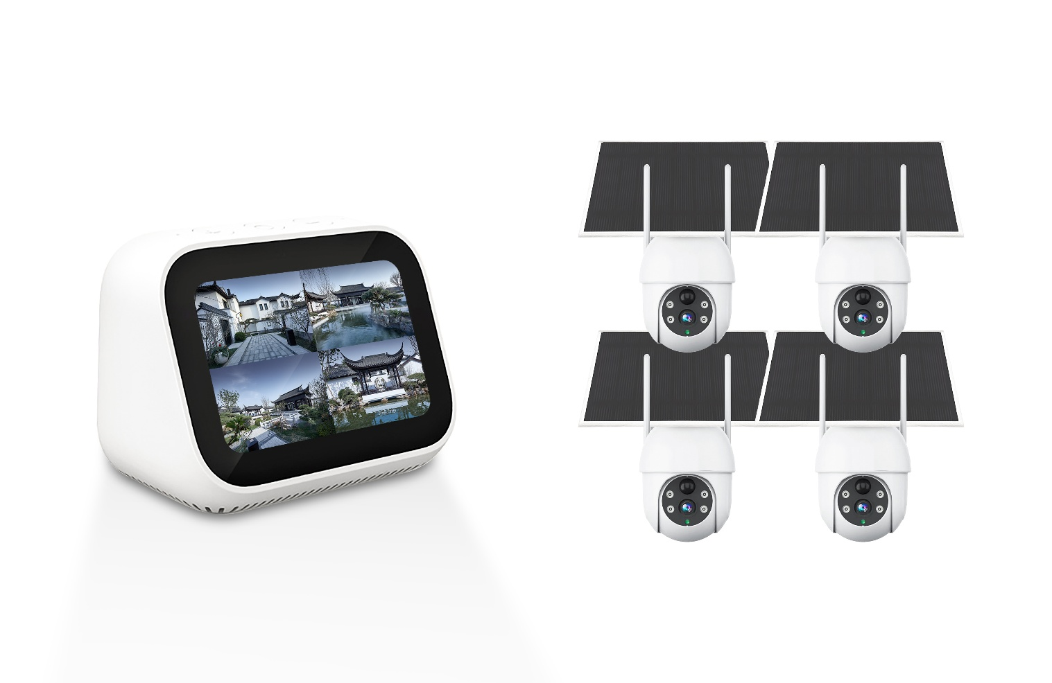
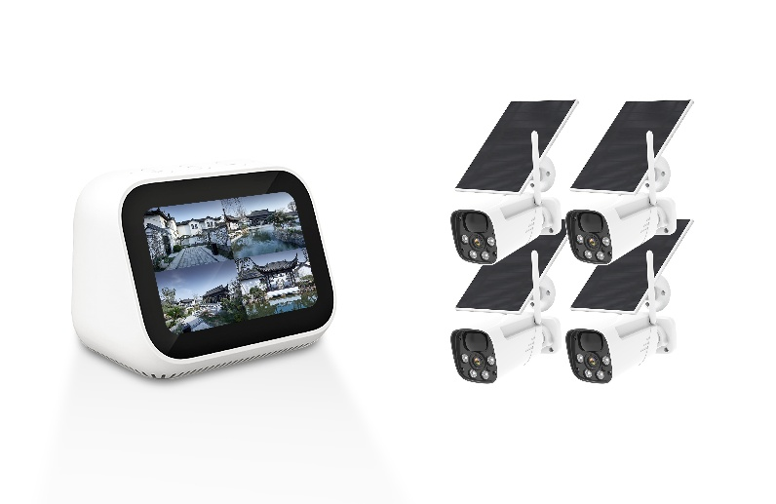
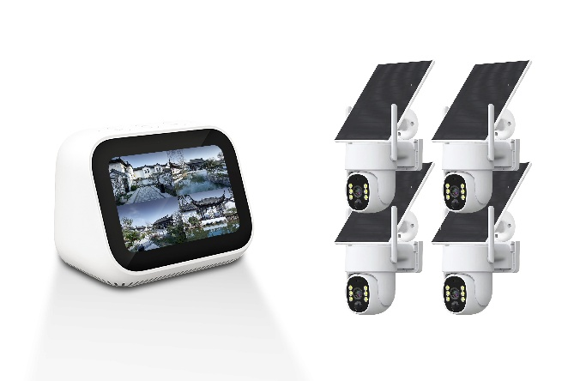

Slide 43
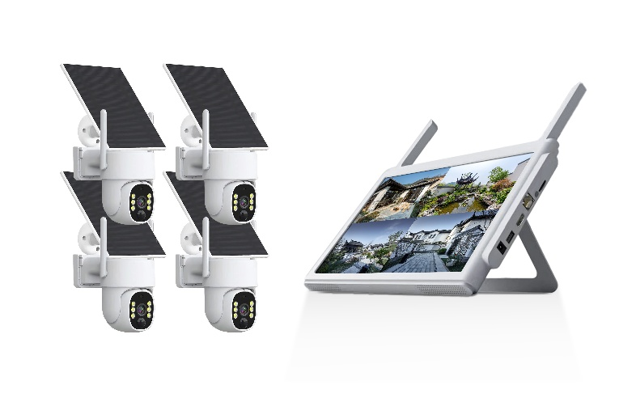




Slide 44





4.39+M2
4.39+TBG07
4.39+CW52
111$
112$
112$
4.39+TBG06
4.39+TBG13
112$
112$

Slide 45
107$
108$
108$
108$
108$

Slide 46
137$
137$
137$
137$
137$

